Slide 1

Cloud Adoption Framework for Azure

Slide 2
Agenda
● Overview: Cloud Adoption Framework for Azure
● Strategy
● Plan
● Ready
● Adopt
● Govern
● Manage
● Q&A
Notes:
Agenda:
● Why is cloud adoption important?
● Overview: Microsoft Cloud Adoption Framework for Azure
● Overcoming common blockers
● Tools, templates, and assessments
● Find a Partner

Slide 3
Why is cloud adoption important?

Slide 4
Modernization drives measurable ROI
Shifting from on-premises operations to the cloud favors your bottom line
Benefits (Three-Year)
$7.3M
Research findings¹ indicate organizations with Azure-mature tenure (three-years):
experience benefits of $13.1 million over three years versus costs of $2.3 million
benefits add up to a net present value (NPV) of $10.8 million and an ROI of 478%.
$3.0M
$1.9M
$927.1K
Avoided on-premises
Avoided on-premises
Income from new and
Income from new
infrastructure costs
FTE costs
larger online B2C sales
enterprise sales
1Forrester Total Economic Impact™ Study Commissioned By Microsoft, August 2019, The Total Economic Impact™ Of Microsoft Azure IaaS Cost Savings And Business Benefits Enabled By Azure Infrastructure-As-A-Service (IaaS)
Notes:
<Key point>: modernization drives measurable growth for your business.
Now, with the buy-in from your leadership team, you can lead the way to change—and modernization.
You might be thinking—“What’s in it for me, my business, and our bottom line?
There are a lot of growth benefits that come with change—and they are measurable.
You might be considering a hybrid cloud solution for your growing business.
Modernize some on-prem apps and move other apps to the cloud.
Moving to hybrid cloud solutions will save you on-premises hardware costs.
Leadership can allocate less funds to pay for reduced staffing at her on-premises datacenter.
You grow more online B2C sales—tapping into more computing resources to handle sudden peaks in demand.
It’s an evolution—and carefully planned, business-wide change of moving to the cloud.
<Transition>: Let’s look at how Azure enabled Dentsu Aegis to do more, and achieve more, with the cloud.

Slide 5
Digital transformation
91%
68%
say digital transformation is increasing profits
of business leaders see digital transformation as a way of sparking innovation and finding efficiencies¹
85%
64%
say they must offer digital services or become irrelevant
say they have less than 4 years to complete a digital transformation or they may go out of business
¹Research Report, ISACA, Information Systems Audit and Control Association, 2018
Notes:
<Key point>: Digital Transformation is the evolution of business
Digital transformation embraces the necessity of change.
What kind of change are we talking about?
—optimization
—identifying and implementing efficiencies
There is no magic “efficiency” switch to flip.
It’s about a process of change—changing the foundation of how your business works.
Many of you already know if they don’t digitally transform and evolve, their businesses won’t survive.
And now, they’ve committed to making this transformation happen.
But companies need guidance during this challenging process—technical guidance that’s tailored to their industry and considers their business requirements and objectives.
<Transition>: Change is necessary in today’s competitive business climate. So, how do you implement changes to your business to be more efficient?

Slide 6
Change requires radical thinking.
Change is difficult.
We understand that.
Change impacts your people, your culture, and feels risky.
It requires leaders to adapt, take risks, and learn quickly.
Change requires a culture shift
within your organization,
and starts with you.
Notes:
<Key point>: change is hard—because it affects people, not just process.
The decision to commit to change is only the first step.
Whether evolving to meet increased market demand, or face tough foreign competition, change is inevitable.
Many business leaders already realize that change is much more than just swapping out technologies.
It’s an incremental process—evolving in how you’re doing business that affects culture company-wide—all your employees. And it starts with you, the business leader.
You know that the journey to the cloud is hard, but necessary to continue to grow in an evolving marketplace.
<Transition>: For businesses, it’s step-by-step path to modernization—and growth.

Slide 7
Overview: Microsoft Cloud Adoption Framework for Azure

Slide 8
Achieve balance. Deliver modernization. Deli
Best practices
Templates
People
Process
Technology
Documentation
Tools
Control & Stability
Speed &
Results
Align—business, people and technology strategy.
Achieve—business goals with actionable, efficient, and comprehensive guidance.
Deliver—fast results with control and stability.
Notes:
<Key point>: Change is more than adopting technology. It’s adapting how you do business.
The Microsoft Cloud Adoption Framework for Azure means changing how you do business—not just swapping out technology, but changing your enterprise, the culture behind it, and you too.
We share best practices from our employees, partners, and customers who have already undertaken the cloud journey.
The Cloud Adoption Framework brings together people, process, and technology—a strategy that’s aligned to your business goals.
Quickly—efficiently, and with actionable guidance, it provides guidance for your organization’s agile business transformation.
Leading people through change is difficult. It’s not just the technology that changes. It’s your people and processes too.
We can help guide you through.
<Transition>: How does the Cloud Adoption Framework work for your business?

Slide 9
Plan
An iterative process that supports your business … as it evolves
Govern
Manage
Define strategy
Adopt
Ready
Notes:
<Key point>: An iterative process that supports your business needs.
We can help you on your cloud adoption journey.
We put the experience of employees, partners, and customers to work for you.
We work together with you—to build your plan for cloud adoption.
It starts with your vision.
Crystallize your vision for cloud adoption by working cross-functionally with your finance, marketing, sales, and HR departments.
Work to gain consensus on:
Clear motivations: Why are we adopting the cloud?
Defined business outcomes: What results do we expect to see from adopting the cloud?
Business justification: How will the business measure success?
We work with you to build an actionable cloud adoption plan with strategic (above) and tactical inputs such as defining your workloads and assets, aligning your organization, and readying necessary skills.
This cross-team effort is balanced out by the technical team, who will take this vision and execute technical deployment.
We recommend iterative planning to drive your cloud adoption effort—enabling your technical teams to move incrementally, in phases towards cloud adoption.
<move to the Ready phase to explain another example, to show iterative process, if necessary>
You plan will unite your organization in a cross-team initiative that, together, will forecast, budget, implement, and manage its success.
Our approach is Agile, and we consider security, governance, cost-optimization, and hybrid-cloud awareness by default.
Microsoft will work with you, learning how you do business—and help you adapt.
Your organization is changing—moving towards modernization, with challenging new markets, products, customer engagement.
We can help you get there.
<Transition>: What does a cloud adoption framework look like?

Slide 10
Microsoft Cloud Adoption Framework for Azure
Proven guidance to accelerate your cloud adoption journey
Define strategy
Define business justification and expected outcomes
Plan
Align actionable cloud adoption plan to business outcomes
Ready
Prepare people, process and environment for change
Adopt
Migrate or Innovate
Implement desired changes across IT and business processes
Govern
Comply, control and secure
Manage
Operate and optimize
https://aka.ms/adopt/overview
Notes:
<Key point>: Cloud Adoption Framework—modular phases of adoption.
As your organization evolves, the Cloud Adoption Framework adapts to your business needs.
Each module in the diagram is an iterative phase that advances your business through the complete lifecycle of cloud adoption.
Customers can choose the phase best-suited to their degree of cloud adoption maturity. The Cloud Adoption Framework offers a guiding methodology to cloud adoption, with specific approaches to overcoming common blockers to cloud adoption in each module, such as “Define Strategy,” “Plan,”, etc.
The Cloud Adoption Framework offers the enterprise a modular framework of how to incrementally onboard to the cloud.
Cloud adoption shifts how companies obtain, make use of, and lock down their technology resources.
And—this kind of modular framework flips the model of how enterprises operate:
Transitions organizations to need-based consumption of technology resources
Change from cap-ex (capital expenditure) to op-ex (operating expenditure) model
Cloud model assumes security, governance, cost-optimization, and hybrid cloud by default
Develop a future-ready workforce—developing and deploying cloud skill readiness organization-wide
As an organization progresses through the Cloud Adoption Framework, what are the main goals of each methodology of “Define Strategy,” “Plan,” you can focus efforts on?
<Transition>: Let’s look at some possible motivations for cloud adoption, and what some common blockers are that the Cloud Adoption Framework can help you resolve.

Slide 11




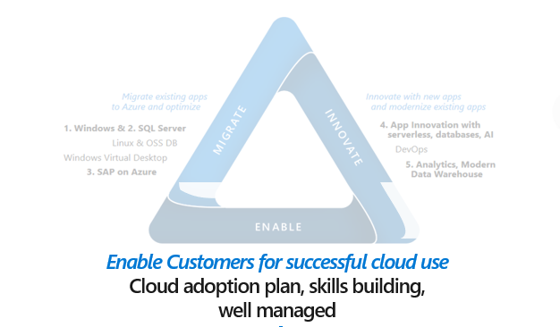


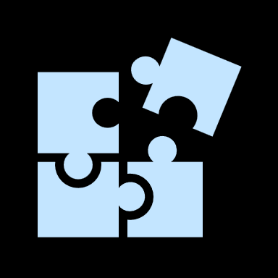

Critical for our partners to adopt the Microsoft Cloud Adoption Framework for increased success in the cloud
The Cloud Adoption Framework shows up in everything we do with customers, and across our field and partner communities
Actionable
Expert created
Comprehensive
Flexible
Aligning with MS Sales and Partner priorities
Deeper customer satisfaction, greater ACR with alignment to cloud native guidance and tooling
Get recognized and promoted as a CAF ready partner
Co-sell CAF aligned solutions with Microsoft

Slide 12
Common motivations and scenarios

Slide 13
Cloud Adoption Motivations
Engage stakeholders across business and technology to understand your motivations for cloud adoption
Migration Motivations
Cost Savings
Reduction in vendor or technical complexity
Optimization of internal operations
Increase business agility
Prepare for new technical capabilities
Scale to meet market demands
Scale to meet geographic demands
Critical Business Events
Data center exit
Mergers, acquisition or divestiture
Reductions in capital expenses
End of support for mission critical technologies
Regulatory compliance, data sovereignty requirements
Reduce disruptions and improve IT stability
Innovation Motivations
Prepare for new technical capabilities
Build new technical capabilities
Scale to meet market demands
Scale to meet geographic demands
Improve customer experiences / engagements
Transform products or services
Disrupt the market with new products or services
Notes:
<Key point>: There is no single, typical cloud adoption motivation in cloud adoption—typically there are more than one.
Cloud adoption is an iterative process. There can be many motivations for why your organization is planning digital transformation.
It’s important to engage cross-functional business groups across the enterprise to explore cloud adoption motivations.
<Transition>: What are some common scenarios leading to cloud adoption—what do they look like?

Slide 14
Migrate existing workloads Managed From Modernization
Define Strategy
Plan
Ready
Adopt
1
3
Gather data and analyze assets and workloads
6
Build skills readiness plan
8
Migrate first 10 workloads
Align stakeholders
2
Align partner support
7
Deploy an aligned landing zone
4
Make a business case
5
Create migration plan
Govern
Manage
9
Hand-off production workloads to cloud governance
10
Hand-off production workloads to cloud operations
aka.ms/adopt/getstarted-migrate
Notes:
<Key point>: Here are the iterative steps that enable the customer journey of Accelerate migration.
Step 1: Align stakeholders
Gain agreement on migration motivations.
Capture desired business outcomes and measure them with metrics.
Step 2: Align partner support
Microsoft Partners, services, and programs are available to support your migration journey.
Step 3: Gather data and analyze assets and workloads
Inventory existing systems: Validate the business case by using data about the current state environment.
Incremental rationalization: Perform quantitative analysis of that data and a deep qualitative assessment of the highest priority workloads.
​Step 4: Make a business case
Evaluate the initial high-level return from a potential cloud migration.
Ensure that all stakeholders align on a data driven decision whether overall adoption of the cloud is a wise business decision.
Step 5: Create a migration plan
Cloud adoption plan template: Deploy the basic template.
Workload alignment: Define workloads in the backlog.
Effort alignment: Align assets and workloads in the backlog to clearly define effort for prioritized workloads.
People and time alignment: Establish iteration, velocity (people's time), and releases for migrated workloads.
Step 6: Build a skills readiness plan
Quickly evaluate required and existing skills of the team, to better understand what skill requirements should be addressed.
Step 7: Deploy an aligned landing zone
Choose a landing zone: Find the right approach to deploying a landing zone based on your adoption pattern, then deploy that standardized code base.
Expand your landing zone: Regardless of the starting point, identify gaps in the deployed landing zone to add required components for resource organization, security, governance, compliance, and operations.
Step 8: Migrate your first 10 workloads
(Iterative process—repeated every migration).
Assess workloads: Assess each batch of workloads to evaluate cost, architecture, and deployment tooling.
Deploy workloads: Replicate functionality in the cloud using IaaS, PaaS, cloud-native, or other modernization solutions.
Release workloads: Test, optimize, document, and review. Release by handing off for governance, management, and security.
Step 9: Hand off production workloads to cloud governance
Governance approach: Outline a process for thinking about corporate policy and processes. Then build the disciplines required to deliver on governance across your cloud enterprise adoption efforts.
Initial governance foundation: Understand the Identity Baseline discipline, Security Baseline discipline, and Deployment Acceleration discipline, required to create a governance minimum viable product (MVP) to serve as the foundation for all adoption.
Step 10: Hand off production workloads to cloud operations
Establish a management baseline
Define business commitments
Expand the management baseline
Get specific with advanced operations
​
<Transition>: What if you want to Build new products and services?

Slide 15
Build new products and services Managed To Modernization
Define Strategy
Plan
Ready
Adopt
1
3
Gather data and analyze assets and workloads
7
Deploy an aligned landing zone
8
Innovate in the cloud
Document the business strategy
2
Evaluate business justification
4
Plan asset migration
Govern
Manage
5
Align governance requirements to adoption plan
6
Define operational needs and business commitments
aka.ms/adopt/getstarted-buildnew
Notes:
​<Key point>: Here are the iterative steps that enable the customer journey of Build new products and services.
Step 1: Document the business strategy
Motivations: Strategic align, seek consensus on motivations for the migration effort. Understanding and categorizing motivations and common themes from various stakeholders across business and IT.
Business outcomes: After motivations are aligned, capture the desired business outcomes, using clear metrics to measure overall transformation.
Building a cloud migration business case: Start to develop a migration business case with clear guidance on formulas and tools to help business justification.
Step 2: Evaluate the business justification
Business justification: Before evaluating opportunities to innovate in the cloud, complete a high-level business justification to establish stakeholder alignment for the overall adoption plan.
Business value consensus: Identify how that innovation can align to and drive business value.
Step 3: Gather data and analyze assets and workloads
Inventory existing systems: Validate the business case by using data about the current state environment.
Incremental rationalization: Perform quantitative analysis of that data and a deep qualitative assessment of the highest priority workloads.
​Step 4: Plan for migration of dependent assets
Cloud adoption plan template: Deploy the basic template.
Workload alignment: Define workloads in the backlog.
Effort alignment: Align assets and workloads in the backlog to clearly define effort for prioritized workloads.
People and time alignment: Establish iteration, velocity, and releases for the workloads.
Step 5: Align governance requirements to your adoption plan
Governance approach: Outline a process for corporate policy and processes. Build the disciplines required to deliver on governance across cloud enterprise efforts.
Define corporate policy: Identify and mitigate business risks.
Step 6: Define operational needs and business commitments
Define business commitments: Create business alignment in cloud management.
Get specific with advanced operations: Go beyond your management baseline and apply design principles and advanced operations. If advanced operations are required to support your operations needs, evaluate the business commitments to determine operational responsibilities for both teams.
Step 7: Step 7: Deploy an aligned landing zone
Choose a landing zone: Deploy a landing zone based on your adoption pattern, then deploy that standardized code base.
Expand your landing zone: Regardless of the starting point, identify gaps in the deployed landing zone to add required components for resource organization, security, governance, compliance, and operations.
Step 8: Innovate in the cloud
Business value consensus: If more than three months have passed since the last business value consensus, or if never completed, Identify how innovation can align to and drive business value.
Azure innovation guide: Use the Azure innovation guide to speed up the deployment of innovative solutions by understanding the tools and processes to help build a minimum viable product (MVP).
Innovation best practices: Combine Azure services to create a toolchain for digital invention.
Feedback loops: Develop improved feedback loops to quickly deliver impactful innovations to your customers.
​
<Transition>: What if you want to Unblock environmental design and configuration?​

Slide 16
Unblock environment design and configuration
Define Strategy
Plan
Ready
Adopt
1
Document the business strategy
2
Assess digital estate
4
Deploy first landing zone
3
Create cloud adoption plan
7
Expand the landing zone
Govern
Manage
5
Deploy initial governance
foundation
6
Implement an operations baseline
aka.ms/adopt/getstarted-environment
Notes:
<Key point>: Here are the iterative steps that enable the customer journey of Unblock environmental design and configuration.
Step 1: Document the business strategy
Motivations: Strategic align, seek consensus on motivations for the migration effort. Understanding and categorizing motivations and common themes from various stakeholders across business and IT.
Business outcomes: After motivations are aligned, capture the desired business outcomes, using clear metrics to measure overall transformation.
Building a cloud migration business case: Start to develop a migration business case with clear guidance on formulas and tools to help business justification.
Step 2: Assess the digital estate
Inventory existing systems: Validate the business case by using data about the current state environment.
Incremental rationalization: Perform quantitative analysis of that data and a deep qualitative assessment of the highest priority workloads.
Step 3: Create a cloud adoption plan
Cloud adoption plan template: Deploy the basic template.
Workload alignment: Define workloads in the backlog.
Effort alignment: Align assets and workloads in the backlog to clearly define efforts for prioritized workloads.
People and time alignment: Establish iteration, velocity, and releases for the migrated workloads.
​Step 4: Deploy the first landing zone
Choose a landing zone: Find the right approach to deploying a landing zone based on your short-term adoption plan, then deploy that standardized code base.
Expand your landing zone: Don't attempt to meet long-term governance, security, or operation constraints yet, unless they're required to support the short-term adoption plan.
Step 5: Deploy an initial governance foundation
Governance approach: Outlines a process for thinking about corporate policy and processes, then build the disciplines required to deliver on governance across cloud enterprise adoption efforts.
Governance benchmark tool: Find gaps in your current state so that you can plan for the future.
Initial governance foundation: Understand the Identity Baseline discipline, Security Baseline discipline, and Deployment Acceleration discipline required to create a governance minimum viable product (MVP) to serve as the foundation for all adoption.
Step 6: Implement an operations baseline
Expand the management baseline: Establish actionable best practices for operational management in the cloud.
Define business commitments: Create business alignment in cloud management.
Expand the management baseline: Establish actionable best practices for operational management.
Get specific with advanced operations: Go beyond your management baseline and apply design principles and advanced operations.
Step 7: Expand the landing zone
Refactor landing zones: Modify or restructure source code to optimize the output, accelerate migration, and remove common blockers.
Test-driven development of landing zones: Use test-driven DevOps processes to improve the quality of new features and improvements in code-based solutions.
Expand landing zone governance: Improve the landing zone governance foundation to integrate cost controls, establish basic tooling to allow for scale, and will make it easier for the cloud governance team to deliver on the Five Disciplines of Cloud Governance.
Expand landing zone operations: Use landing zone governance best practices with naming and tagging standards, cost tracking across workloads, scaling with multiple subscriptions, and organizing and managing subscriptions.
Expand landing zone security: Use landing zone best practices to protect data and assets, building on the test-driven development approach to landing zones, expanding or refactoring the landing zone to account for heightened security requirements.
​
<Transition>: Let’s look at the Get Started guides in Microsoft Cloud Adoption Framework Documentation
​

Slide 17
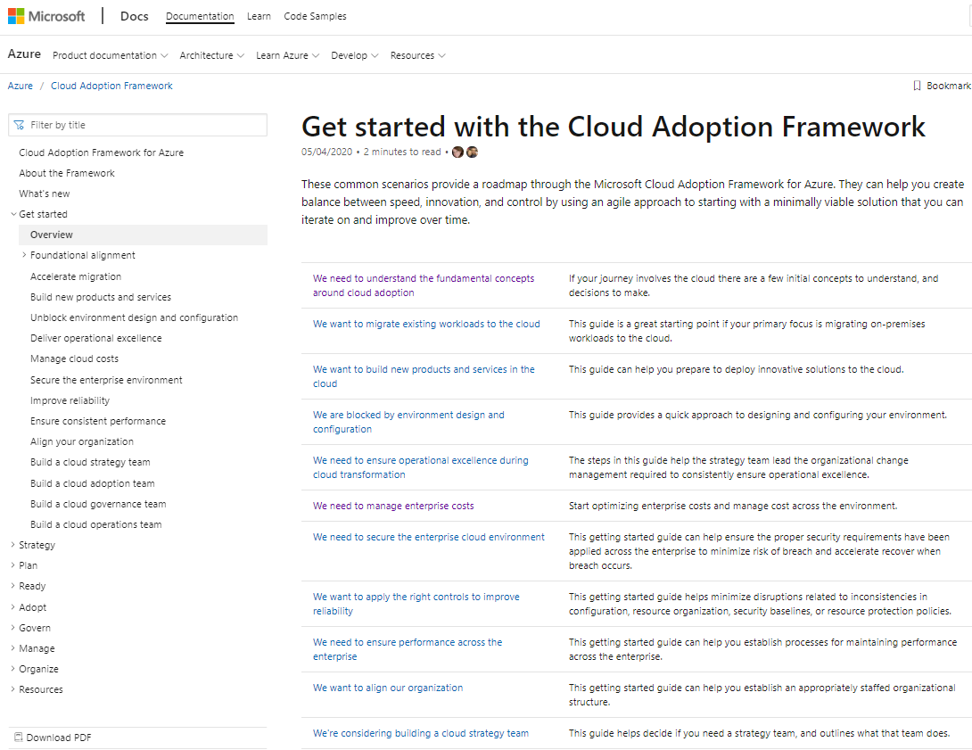
Find your path—get started on your journey
Use the Get Started Guides as your roadmap through the Cloud Adoption Framework to overcome common blockers
Notes:
<Key point>: Find more Get Started guides in Microsoft Cloud Adoption Framework Documentation
<Transition> There are a variety of tools, templates and assessments that will support your path to digital transformation; we will now look at a high-level overview of those resources

Slide 18
Tools, templates, and assessments

Slide 19
Tools, templates, and assessments
Define strategy
Plan
Ready
Adopt
Cloud journey tracker
Business outcome template
Azure DevOps demo generator
Cloud adoption plan template
Azure setup guide
Readiness checklist
Naming and tagging tracking template
Landing zone blueprints
Strategic migration assessment and readiness tool (SMART)
Azure migration guide
Azure innovation guide
Govern
Manage
Governance benchmark
Governance process template
Cost Management process template
Deployment acceleration process template
Identity process template
Resource consistency process template
Security baseline process template
Microsoft Azure Well-Architected Review
Best practices source code
Operations management workbook
aka.ms/adopt/tools-templates
Notes:
<Key point> We have tools, assessments, and other assets to support your cloud adoption journey.
<Transition> Although the tools, templates, and assessments enable you to manage your own journey, not everyone wants to do this alone. Let's talk about the role of Microsoft Partners - and how they can lighten the load.

Slide 20
Microsoft Cloud Adoption Framework for Azure
Define strategy
Understand motivations
Financial considerations
Technical considerations
Create a business case
Define strategy
Understand motivations
Financial considerations
Technical considerations
Create a business case
Plan
Digital estate
Initial organization alignment
Skills readiness plan
Cloud adoption plan
Ready
Azure setup guide
First landing zone
Expand the landing zone
Best practice validation
Adopt
Migrate First workload migration Expanded scenarios Best practice validation Process improvements
Innovate Innovation guide Expanded scenarios Best practice validation Process improvements
Govern
Methodology
Benchmark initial best practice
Governance maturity
Manage
Business commitments
Operations baseline
Operations maturity
https://aka.ms/adopt/overview
Notes:
The Microsoft Cloud Adoption Framework aligns different phases of the cloud adoption lifecycle to ensure easy access to the right guidance at the right time.
This framework consists of multiple phases, including:
Strategy: Define business justification and expected outcomes.
Plan: Create and align actionable adoption plans to desired business outcomes.
Ready: Prepare the cloud environment for the planned changes.
Migrate: Migrate and modernize existing workloads on the cloud.
Innovate: Develop new cloud-native or hybrid solutions.
Govern: Govern the environment and workloads to ensure industry standards and regulatory requirements.
Manage: Conduct operations management for cloud and hybrid solutions.
Let’s look at the other methodologies within the Framework's cloud adoption lifecycle.

Slide 21
Define and document your cloud strategy
Help stakeholders to understand— your organization's desired business outcomes for cloud adoption
Motivations
Understand motivations for making a move to the cloud
Business outcomes
Engage stakeholders to document your specific business outcomes
Financial considerations
Investigate the financial considerations around how the cloud will impact your financial position, accounting KPIs, and processes that Chief Financial Officers and finance teams need to understand
Technical considerations
Discover technical considerations around how cloud adoption will help improve how you manage and maintain your cloud and workloads
Notes:
Defining strategy includes following these four steps to help you document your business strategy efficiently—
understanding motivations, business outcomes, financial considerations, and technical considerations.
Review the main goal of each of the four steps of the Strategy methodology.
How can we assess the state of our cloud adoption effort, and begin building a cloud adoption strategy?

Slide 22
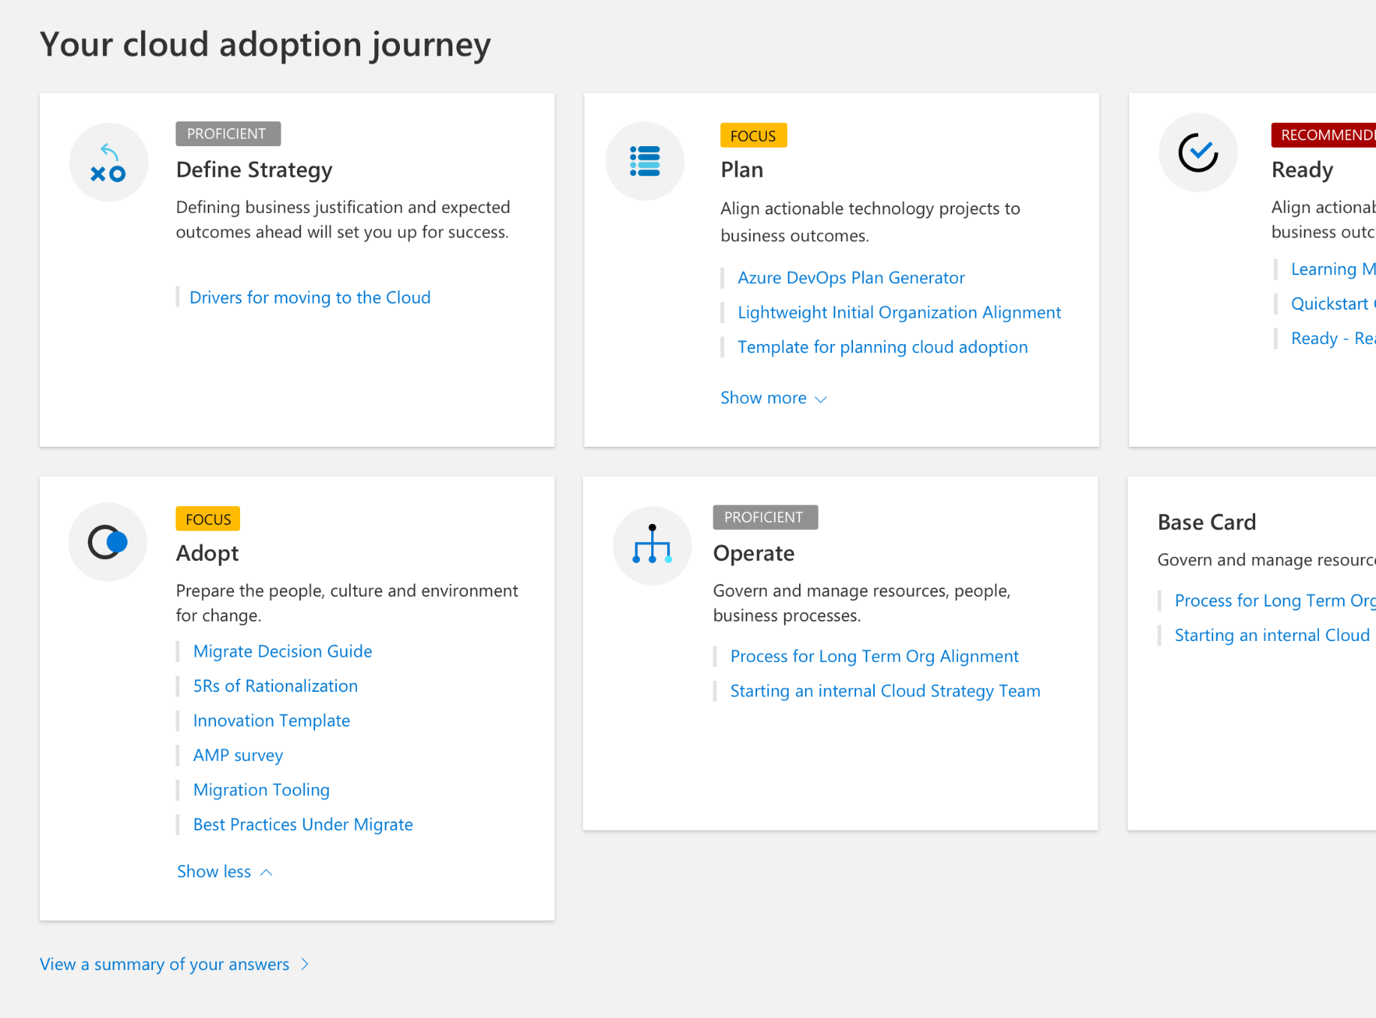
Identify your cloud adoption path
Assess the current state of your cloud adoption using the Cloud Journey Tracker
Help to build out your cloud adoption strategy by completing the strategy and plan template and business outcome template
Notes:
There are several useful tools to assess the state of your organization's cloud effort (and the rationale behind it).
Review the Cloud Journey Tracker to understand where you are in your cloud journey and understand your business motivations for cloud adoption.
Point out the benefits the business outcome template and strategy and plan template—capture business outcomes to be used later in the development of customer transformation journey strategies.
Let's look at how to engage stakeholders to begin the process of understanding cloud adoption motivations.

Slide 23
Understanding your motivations

Slide 24

Why are you moving to the cloud?
Notes:
Think about what your motivations are—
WHY are you moving to the cloud?
Let's begin to explore some of your motivations for moving to the cloud.

Slide 25
Motivations for cloud adoption
Engage stakeholders across business and technology to— define, document, and understand your motivations for cloud adoption
Migration motivations
Cost savings
Reduction in vendor or technical complexity
Optimization of internal operations
Increase business agility
Prepare for new technical capabilities
Scale to meet market demands
Scale to meet geographic demands
Critical business events
Datacenter exit
Mergers, acquisition or divestiture
Reductions in capital expenses
End of support for mission-critical technologies
Regulatory compliance, data sovereignty requirements
Reduce disruptions and improve IT stability
Innovation motivations
Prepare for new technical capabilities
Build new technical capabilities
Scale to meet market demands
Scale to meet geographic demands
Improve customer experiences / engagements
Transform products or services
Disrupt the market with new products or services
Notes:
There is no single, motivating factor for cloud adoption—there is typically more than one motivation involved.
Cloud adoption is an iterative process.
There can be many motivations for why your organization is planning digital transformation.
It’s important to engage cross-functional business groups across the enterprise to explore cloud adoption motivations.
How do you define and document your motivations for moving to the cloud?

Slide 26
Cloud Adoption Motivation*
Migration Motivations
Critical Business Events
Cost Savings
Reduction in vendor and technical complexity
Optimization of internal operations
Increase business agility
Introduce new technical capabilities
Data center exit Winterthur Paulstrasse
Reductions in capital expenses and maintenance cost, both for software and hardware
End of support for mission critical technologies
Regulatory and Finma compliance
Innovation Motivations
Build new technical capabilities
Transform and improve services
Attract new Financial/Banking Clients
*Based on Cloud Adoption Framework

Slide 27
Your motivations for cloud adoption are complex— now let’s classify them
Your motivations for cloud adoption may fall in multiple categories
Trends will likely emerge in building your list of motivations
Motivations are often linked more closely to one classification than to others
Help guide the development of your cloud adoption strategy— using the main classification of your motivations
Notes:
Motivations are not static, but and because they reflect why you want to move to the cloud, might fall into several different categories.
When a response to critical business events is the highest priority, it's important to get started with migration early, often in parallel with strategy and planning efforts. Taking this approach requires a growth mindset and a willingness to iteratively improve processes, based on direct lessons learned.
When migration is the highest priority, strategy and planning will play a vital role early in the process. We recommend that you implement the first workload in parallel with planning efforts, to help the team understand and anticipate any learning curves that are associated with cloud adoption.
When innovation is the highest priority, strategy and planning require additional investments early in the process to ensure balance in the portfolio and wise alignment of the investment made during cloud adoption. For further information and guidance, see Understand the innovation journey.
To ensure wiser decision-making, all participants in the migration process should have a clear awareness of their motivations.
Let's examine possible migration-motivated strategies and business outcomes.

Slide 28
Understand your strategies and business outcomes— driven by migration motivations
Migration motivations like increasing cost savings or optimizing internal operations are among the most common, but not necessarily the most significant drivers for cloud adoption
Reducing vendor or technical complexity, for example—is important to achieve, but most effectively used to transition to other, more useful worldviews on the cloud adoption journey: cloud migration
Strategies driven by migration motivations produce successful business outcomes:
Increasing cost savings. Read the customer story.
Reducing vendor or technical complexity
Optimizing internal operations
Increasing business agility. Read the customer story.
Preparing for new technical capabilities
Scaling to market demand
Scaling to geographic demand. Read the customer story.
Notes:
The migration motivations listed near the top of the motivations table are the most common, but not necessarily the most significant, reasons for adopting the cloud. These outcomes are important to achieve, but they're most effectively used to transition to other, more useful worldviews. This important first step to cloud adoption is often called a cloud migration.
The Migrate methodology in the Cloud Adoption Framework outlines the strategy for executing a cloud migration.
Some motivations align well with a migrate strategy. Motivations at the top of this list will likely have significantly less business impact than those toward the bottom.
Migration motivation-driven strategies have helped to produce successful business outcomes, like:
Increasing cost savings. Read the customer story.
Reducing vendor or technical complexity.
Optimizing internal operations.
Increasing business agility. Read the customer story.
Preparing for new technical capabilities.
Scaling to market demand.
Scaling to geographic demand. Read the customer story.
Let's examine possible innovation-motivated strategies and business outcomes.

Slide 29
Understand your strategies and business outcomes— driven by innovation motivations
Transformative products and services are built on top of data, insights, and customer experiences
Modern applications are driving this data across innovative customer experiences
Strategies driven by innovation motivations produce successful business outcomes:
Increasing business agility
Preparing for new technical capabilities
Building new technical capabilities. Read the customer story.
Scaling to market demand
Scaling to geographic demand
Improving customer experience and engagement. Read the customer story.
Transforming products or services
Notes:
Data is the new commodity, and modern applications are the supply chain driving that data into various experiences. In today's business market, it's hard to find a transformative product or service that isn't built on top of data, insights, and customer experiences. The Innovate methodology in the Cloud Adoption Framework includes motivations aligned to a technology strategy that appear lower in the Innovation column of the motivation list above.
The motivations listed below focus an IT organization more on an innovate strategy than a migrate strategy.
Innovation motivation-driven strategies have helped to produce successful business outcomes.
Increasing business agility.
Preparing for new technical capabilities.
Building new technical capabilities. Read the customer story.
Scaling to market demand.
Scaling to geographic demand.
Improving customer experience and engagement. Read the customer story.
Transforming products or services.
How does your business benefit from documenting your desired business outcomes?

Slide 30
Identifying your business outcomes

Slide 31

Identify business outcomes
Engage stakeholders and discuss your desired outcomes
Define your organization's business outcomes— to support transparency and develop cross-functional partnerships
Adopt cloud economics best practices to optimize your cloud investment
Plan conversations with various personas on business outcomes to trigger discussion on:
Finance leadership
Marketing
Sales
Human resources
Executive leadership
Review business outcomes by category—define your organization's outcomes
Complete the business document template to identify your business outcomes
Notes:
Optimize your cloud investment using cloud economics
What are the fundamentals of cloud economics in Azure? Whether you're running existing workloads or designing new solutions in Azure, learn best practices guidance to navigate the economics of the cloud for your organization, and optimize your operating costs in Azure based on your specific workloads. Get started with successfully building your cloud business case with key financial and technical guidance, and maximize the full benefit of your cloud investment.
Learn more about how cloud economics works.
Prepare for conversations with different personas
The following are a few business outcomes that tend to trigger conversations with various personas:
Finance leadership: Increase profitability while driving compliance.
Marketing: Acquire and retain customers, build reputation.
Sales: Accelerate sales, improve customer lifetime value.
Human resources: Retain, recruit, and empower employees.
Executive leadership: Meeting market growth requirements and environmental sustainability metrics.
Sample outcomes by category
Speaking in business outcomes can feel like a foreign language to many technically minded individuals. To help ease translation, we curate a set of business outcome examples. You can use the following examples to inspire and demonstrate business outcomes that are based on actual transformation journeys.
To help you find business outcomes more easily, we've separated them into the following categories. This approach tends to drive consensus-building conversations across business units.
Fiscal outcomes
Financial or fiscal performance is the cleanest business outcome for many business leaders, but not the only one.
Agility outcomes
Today's fast-changing business environment places a premium on time. The ability to respond to and drive market change quickly is the fundamental measure of business agility.
Reach outcomes
In a constantly shrinking market, global reach (ability to support global customers and users) can be measured by compliance in geographies that are relevant to the business.
Customer engagement outcomes
Social marketplaces are redefining winners and losers at an unheard-of pace. Responding to user needs is a key measure of customer engagement.
Performance outcomes
Performance and reliability are assumed. When either falters, reputation damage can be painful and long-lasting.
Sustainability goals
Organizations are increasingly discussing environmental goals and sustainability targets.
Learn more about sustainability goals.
Each of the business outcomes listed in the preceding categories can help facilitate a focused conversation among your business and technical team members. However, you shouldn't limit your conversations to these generic samples. Understanding the unique needs of your own business, and building outcomes that match, maximizes the value of a cloud transformation.
Let's look at what guidance we have in the way of tools and templates for defining business outcomes.

Slide 32


Define and document your business outcomes
Complete the business document template
How master discoverers work…
Stakeholders
Who will see the greatest value in the success of this transformation?
What are your business drivers and objectives?
What are your KPIs?
How will technical capabilities accelerate the success of the business outcome?
Capabilities
Business outcomes
Business drivers
KPIs
Notes:
Use the business outcome template
In this template, business outcomes focus on three topics:
Aligning to stakeholders or business decision makers.
Understanding business drivers and objectives.
Mapping outcomes to specific solutions and technical capability.
Figure 1: Business outcomes visualized as a house with stakeholders, over business outcomes, over technical capabilities.
The business outcome template focuses on simplified conversations that can quickly engage stakeholders without getting too deep into the technical solution. By rapidly understanding and aligning the key performance indicators (KPIs) and business drivers that are important to stakeholders, your team can think about high-level approaches and transformations before diving into the implementation details.
An example can be found on the "example outcome" tab of the spreadsheet, as shown below. To track multiple outcomes, add them to the "collective outcomes" tab.
Figure 2: Example of a business outcome template.
Why is this template relevant?
Discovery is a fundamental tenet of enterprise architecture. If discovery is limited to technical discovery, the solution is likely to miss many opportunities to improve the business. Enterprise architects, solution architects, and other technically minded leaders can master the discovery process by using this template. In effective discovery processes, these leaders consider five key aspects of the business outcome before leading a transformation journey, as shown in the following image:
Stakeholders: Who in the organization is likely to see the greatest value in a specific business outcome? Who is most likely to support this transformation, especially when things get tough or time consuming? Who has the greatest stake in the success of this transformation? This person is a potential stakeholder.
Business outcomes: A business outcome is a concise, defined, and observable result or change in business performance, supported by a specific measure. How does the stakeholder want to change the business? How will the business be affected? What is the value of this transformation?
Business drivers: Business drivers capture the current challenge that's preventing the company from achieving desired outcomes. They can also capture new opportunities that the business can capitalize on with the right solution. How would you describe the current challenges or future state of the business? What business functions would be changing to meet the desired outcomes?
KPIs: How will this change be measured? How does the business know whether they are successful? How frequently will this KPI be observed? Understanding each KPI helps enable incremental change and experimentation.
Capabilities: When you define any transformation journey, how will technical capabilities accelerate realization of the business outcome? What applications must be included in the transformation to achieve business objectives? How do various applications or workloads get prioritized to deliver on capabilities? How do parts of the solution need to be expanded or rearchitected to meet each of the outcomes? Can execution approaches (or timelines) be rearranged to prioritize high-impact business outcomes?
How do you get the most value out of your Azure investment?

Slide 33
Understanding cloud economics

Slide 34
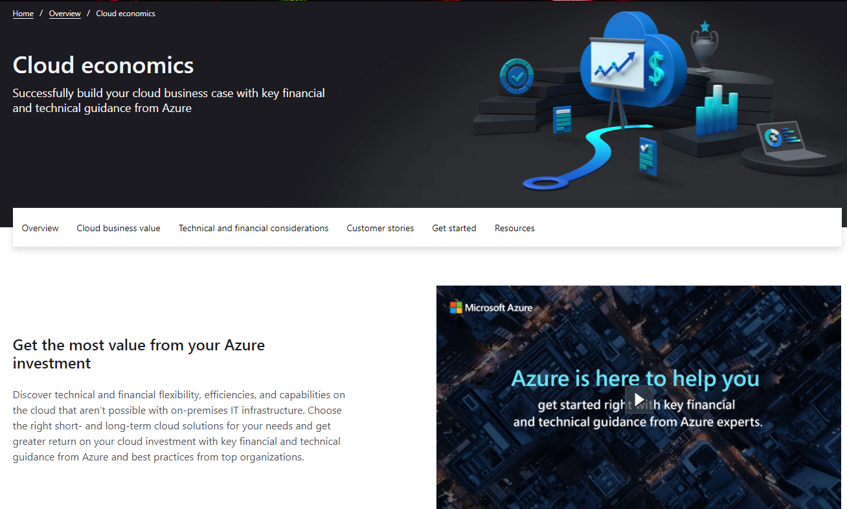

Cloud economics overview
Cloud economics—provides detailed technical and financial guidance from Azure experts—helping you to understand your cloud investment
Save time, budget, and resources—and maximize the benefits from your investment as you chart your cloud journey
Learn more https://www.azure.com/cloudeconomics
Notes:
Getting the most value from your Azure investment—
Discover technical and financial flexibility, efficiencies, and capabilities on the cloud that aren’t possible with on-premises IT infrastructure. Choose the right short- and long-term cloud solutions for your needs and get greater return on your cloud investment with key financial and technical guidance from Azure and best practices from top organizations.
Why are companies moving to the cloud?
Reduced datacenter footprint
Streamline operations and focus on what matters most for your business—like expediting app development—by reducing your datacenter footprint.
Tenthline case study
OPEX pricing models
Enable future growth with flexible, pay-per-use, on-demand cloud benefits and take advantage of an operational expenditure model rather than a traditional capital expenditure model.
TransAlta case study
Staff productivity
Reduce downtime and free up your IT staff from maintenance and patching tasks to spend more time optimizing and innovating.
Oscars case study
Sustainability
Build a clean-energy future and make progress toward your sustainability and business goals with sustainable technologies from Azure.
Bühler Group case study
Scalability
Scale elastically by delivering the right amount of IT resources—for example, more or less computing power, storage, bandwidth—right when they’re needed, and from the right geographic location.
Walgreens case study
Security and compliance
Build resilience and meet compliance requirements proactively— with security that’s built from the ground up, backed by a team of experts, and trusted by enterprises, governments, and startups.
Cerner case study
Availability
Ensure business continuity for mission-critical systems that cannot tolerate interruption in service with high-availability cloud infrastructure from Azure.
Descartes case study
Optimization
Boost workload, operational, and cost efficiencies with free, enterprise-grade management tools, cost-saving offers, and innovative managed services from Azure.
GE case study
Let's talk about the core benefits of your cloud adoption journey.

Slide 35
Core benefits—cloud adoption
Technical benefits
Scalability
Elasticity and on-demand are a huge shift
Improving how you manage, maintain and pay for your cloud
Availability
Every customer consumes the cloud differently, but— there are substantial benefits common to all cloud adoption efforts
Security and compliance
Capacity optimization
Financial benefits
OPEX pricing models
Cloud = flexibility
Getting more out of what you pay for + moving away from fixed and upfront spend
Reduced datacenter footprint
Staff productivity
Sustainability
Notes:
Use cloud economics best practices guidance for your organization to optimize your operating costs in Azure based on your specific workloads.
Build your cloud business case with key financial and technical guidance—and maximize the full benefit of your cloud investment.
There are financial and technical benefits linked to cloud adoption. Cloud consumption will vary across customers, but there are key technical and financial
Let's look at how the cloud will impact the financial position of your organization.

Slide 36
Financial considerations
OPEX pricing models
Reduced datacenter footprint
Staff productivity
Sustainability
Notes:
Digital transformation comes with financial considerations—around how the cloud will impact your financial position, accounting KPIs, and processes that Chief Financial Officers (CFO) and finance teams need to understand, and how to build a business case around some of these concepts.
Your organization’s motivations and business outcomes will help determine how you look at your financials.
How do you use the cloud to make your IT cost structure more flexible—and help you build a business case to migrate to the cloud?
How does cloud pricing work?
The cloud uses a pay-for-what-you-consume model versus the up-front server infrastructure and software licensing costs that you would typically pay on-premises in your data center. The cloud allows you to take advantage of a variable cost model instead of a fixed cost model.
CAPEX to OPEX
One benefit of moving to the cloud is that it shifts how you pay for capacity, from CAPEX to OPEX. Your overall budget allocation moves from a CAPEX investment to OPEX pricing models that can fluctuate based on capacity or utilization of the cloud environment. Your organization will realize meaningful improvements in financial statements, with improved cash flow timing and a reduced need to acquire assets that result in a fixed cost structure.
Reduced data center footprint
A reduced data center footprint is another benefit of a shift to the cloud. On-premises data centers are frequently overbuilt for peaks, resulting in excess capacity and excess spend. In the cloud, you can spin up resources quickly with the flexibility of scalability, where you can scale up and down as needed. Azure operates in many different geographic regions, giving you flexibility to choose where to build your applications. Amortized facilities or co-lo or hosting agreements that you that you have in place are no longer required.
Increased productivity and service delivery
How can the cloud help your team be more productive? It’s critical to consider how DevOps the cloud can improve and drive efficiency in your organization. The cloud can help unlock better DevOps processes, resulting in faster time to market, increased revenue, increased employee productivity, and the ability to deploy products more quickly.
Sustainability
Migrating to the cloud can reduce your carbon footprint and your organization immediately benefits from a sustainability perspective. Data centers that are hosting cloud services, such as Azure, are done at such scale that you benefit from overall sustainability with the least amount of environmental impact.
How will Azure affect our organization when you make the shift to the cloud?

Slide 37
Unlock your financial value—in the cloud
Digital transformation accompanies financial transformation
When moving to the cloud, it is important to understand how Azure will impact:
Financial position
Accounting KPI
Processes
Notes:
As we discussed, we bucketed the benefits of the cloud into two general areas, technical considerations and core financial considerations.
Before we dive too deeply into the financial considerations, I think it's important to also consider how a digital transformation of moving to the cloud will also have a parallel financial transformation. This is generally a set of benefits.
When you're making the shift to the cloud, when you're making an underlying migration, there are financial considerations around how the cloud will impact your financial position, accounting, KPI and processes. Things are shifting. You have dollars going from on-premises environments to cloud environments and so thinking about how the cloud can impact your migration is critical.
In the cloud, there are different cost structures compared to on-prem. On-premises has fixed cost structures. In the cloud, you have to think about what opportunities there are to unlock value. How do you take advantage of some of the technical benefits we talked about and use that to increase your productivity and to increase your economic value when you make that cloud transformation?
How is cloud pricing different from on-prem fixed cost structures?

Slide 38

How does cloud pricing work?
On-premises spend results in a fixed cost structure
On-premises
Cloud
On-prem capacity
On-premises IT costs are often upfront and require initial capital investment
Regardless of underlying demand, you're committed to your initial fixed capacity
Because of your growth expectations, you must pre-buy for expected demand and growth
Cloud costs allow you to benefit from a variable cost model
Elastic workloads can spin up pay-for-what you use
For more fixed workloads, cloud also has reserved instance pricing to take advantage of lower price points for static workloads
IT demand
PAYG + Spot VMs
Reserved capacity
Year 1
Year 2
Year 3
Year 4
Year 5
Notes:
Cloud pricing can be fundamentally different from on-prem fixed structures: Understanding the opportunities, the cloud can provide and how to unlock them is a critical step in evaluating your digital transformation plans.
When you're going from on-prem to cloud, you're really shifting how you acquire capacity. You're going from an upfront cash flow (typically), an upfront spend for your capacity to,
[click]
in the cloud, an over time pay-as-you-go model. On-premises, you are fixed in your capacity regardless of what your demand structure looks like. Your cost structure and your capacity are both fixed. If revenue goes down and you need to reduce your IT cost structure, you are limited. You can't simply reduce it because you already purchased those assets.
Where as, in the cloud, you actually can shift up and down as your IT demand, or revenue generating prospects of the business, change. You're able to shift that capacity up and down and utilize what we call a variable cost model as opposed to a fixed cost model. So, with the elasticity of the cloud we previously talked about, you can actually pay for what you use while also identifying consistent workloads and utilize reserved instance pricing models In order to take advantage of the lower price point for some of those static based workloads.
When we're thinking about shifting to cloud, we discussed the benefit of shifting from CapEx to OpEx. This is a transition. In an on-premises environment, you tend to see spend hitting the capital expenditure category. When you move to the cloud, what you frequently see is a movement over to operating expenses: spend that is over time, as you need it. Rather than paying for a resource up-front, you are paying for the resource as you need it. This results in improved cashflow timing. Time value of money matters. By moving out my spend, aligned with when I need the resources, rather than up-front, I'm helping my economic situation. Additionally, you do have a fair amount of predictability relative to on-premises. With on-premises, I might have infrequent periodic spend. You buy once every 4-5 years. You have a bit of inconsistency. With the cloud, you have more consistent cash flow timing. You also have to make sure you're tracking your spend. You have to make sure you're shifting capital budgets over to operating expense budgets, but you effectively are able to move cash flows out to the future. Another consideration is EBITDA, a financial KPI. It's effectively we call operating income or the profits of your business, but you've added back depreciation and amortization. Because when we go from on-prem to cloud, we're taking things like server depreciation and typically moving them over to cloud spend, your EBITDA is impacted, right? You're no longer getting to add back your depreciation. The reality is this is purely a financial KPI. Decision-making should be really focused upon cash flows and net present value decisions, but it is important to consider the shift and to plan for it. Although EBITDA may imply it, CapEx isn't free. Depreciation and amortization is generated by the fact that you had to buy those servers upfront. Yes, we need to consider the KPI impact, but we also want to make sure we're making decisions from a cash flow point of view.
How does your organization's agility affect the finance department with respect to budget allocations?

Slide 39
Cloud shifts how you pay for capacity
Shift from CAPEX to OPEX
Enables improvements in financial statements—with improved cash flow timing and reduced need to acquire assets resulting in a fixed cost structure
Drives shift in budgets from “capital” budgets to “running” expense budgets
Cloud provides more predictability and better cash flow timing
EBITDA, a financial KPI, is also impacted from the CAPEX to OPEX shift
Notes:
Agility influences not only IT Operations and business units but also impacts finance with respect to allocation of budgets.
For example, it can take weeks or even months in the on-premises world to acquire budget, provision resources or extend new capacity – while in the cloud you can just spin up resources in seconds. Conversely resources can be deprovisioned in a timely fashion and reallocated to needed projects. A super important ability to highlight given that it’s been historically very challenging. This applies not only to the technical resources provisioned but also to the budgetary allocation to support those resources.
Also, in a traditional datacenter you have resources which are assigned for certain workloads for long periods of time, however in the cloud you can be much more flexible in your hardware usage. This is a great example where projecting out or modeling the cost of consumption is crucial – working through the various cloud offerings, architecting not only for service delivery but also cost optimization.
Finally, on-prem is tied to that one location where you have your datacenter, however in the cloud you can quickly spin up your resources pretty much anywhere in the world.
Enabling the increase of business optionality, positive ROI projects and ability to take advantage of new technical opportunities due to reduced sunk investments and technical debt.
Are there other significant benefits from your organization's cloud optimizations?

Slide 40

Cloud optimizations enable— reductions in your datacenter footprint
On-premises data centers are frequently overbuilt for peaks, causing excess capacity and excess spend
Acquiring on-premises datacenter and server capacity has a significant lead-time
Customers frequently invest significantly in advance of underlying demand, resulting in under-utilized capacity
Network
Headcount
Power
Optimization opportunity
Building
Server
Server capacity
MW = Megawatts
On-premises cost
Data center capacity
Notes:
When we're thinking about getting out of datacenters, we're not just exiting our datacenters purely just to get out of your on-premises environment. We are exiting or reducing our data center footprint in a way that allows us to offload some of the lead times that were previously required when provisioning an on-premises environment. Let's unpack that statement a little bit.
In an on-premises environment, I have a mixture of different spend categories. Capital is going to sit in things like server spend, buildings, data center costs, power and cooling, and your head count tied to racking and stacking servers. That cost structure is typically spread across a fixed cost basis. Let's say I’ve got 5 megawatts of capacity. Now if I'm actually looking at the capacity I’m utilizing, I might only be using three of those megawatts. I have the data center space there because I know I may be growing, and so I need to have that ready for when demand comes. But the reality is, I'm spending for an entire environment, but using a portion of it.
And if we look at the next layer below that, server capacity, it's even a further extrapolation. I am not using my servers 24x7 as the previous chart showed. You are provisioning for peaks, you're provisioning for those maximum usage periods. When you remove from on-prem to cloud you're able not just to reduce your data center footprint, but you're able to offload that excess capacity and lead time requirements to Microsoft. Microsoft is making sure the capacity is there for you to spin up and spin down as you need it. You no longer need to keep this capacity pre provisioned.
-----------------------------------------------------------------------------
Previous slide notes:
Agility influences not only IT Operations and business units but also impacts finance with respect to allocation of budgets
For example, it can take weeks or even months in the on-premises world to acquire budget, provision resources or extend new capacity – while in the cloud you can just spin up resources in seconds. Conversely resources can be deprovisioned in a timely fashion and reallocated to needed projects. A super important ability to highlight given that it’s been historically very challenging. This applies not only to the technical resources provisioned but also to the budgetary allocation to support those resources.
Also, in a traditional datacenter you have resources which are assigned for certain workloads for long periods of time, however in the cloud you can be much more flexible in your hardware usage. This is a great example where projecting out or modeling the cost of consumption is crucial – working through the various cloud offerings, architecting not only for service delivery but also cost optimization.
Finally, on-prem is tied to that one location where you have your datacenter, however in the cloud you can quickly spin up your resources pretty much anywhere in the world.
Enabling the increase of business optionality, positive ROI projects and ability to take advantage of new technical opportunities due to reduced sunk investments and technical debt.
Let's take an example of a customer who used modernization to reduce their datacenter footprint.

Slide 41
Microsoft’s sustainability journey—takeaways
Migrating to the cloud reduces carbon emissions
Carbon tax funded innovation and drove the right behavior
Smart buildings reduce energy consumption by as much as 20%
Smart water approaches reduce water usage
Remote work accelerates carbon reductions
Notes:
Finally, I want to talk a little bit about Microsoft’s Sustainability Journey and how we think the cloud can also help you reduce your carbon footprint. Many customers are focused on investing in becoming more green, improving their sustainability and reducing their carbon footprint. When Microsoft migrated to the cloud, we found that we were able to reduce our carbon emissions while also taking advantage of some of the key technologies that Microsoft has built into our data centers.
We use an internal “carbon tax” to fund innovation and drive proper behavior. Smart water approaches have also helped to reduce water usage, and our remote work processes and procedures have also accelerated some of those carbon reductions.
-----------------------------------------------------------------------------------
Previous slide notes:
From level 50 walking deck: https://microsoft.sharepoint.com/sites/sustainability/SitePages/Resources-Collateral.aspx#level-50-walking-deck
On our own sustainability journey, we have accomplished some great things. But, of course, we could NOT have achieved success without the support of our partners, who brought unique ideas to the table, collaborated with one another, and executed bold plans to help land our ambitions and transform our business.
Now, customers are consistently asking us what we’ve learned through our own journey so far, so let’s look at a few takeaways and consider how the concepts we’ve incubated can be improved upon and leveraged elsewhere.
We'll talk about our:
Migration to the cloud and what we've done with Azure to make it more energy efficient
Carbon tax to fuel innovation and help drive better behavior
Innovation around smart buildings and smart water approaches, and finally
Productivity software that helps people connect remotely with a smaller carbon footprint.
Let’s look at an example of a customer leveraging sustainable practices and AI in Microsoft products to reach sustainability targets.

Slide 42
Technical considerations
Scalability
Availability
Security and compliance
Capacity optimization
Notes:
Moving to the cloud includes technical considerations around how it will improve how you manage and maintain your cloud and workloads.
How do you discover the technical flexibility, efficiencies, and capabilities that aren’t possible with your on-premises IT infrastructure, and build a business case to migrate to the cloud?
Technical benefits
Scalability
Scalability, or the ability to scale out your resources depending on usage, utilization, and demand is one of the main technical benefits of moving to the cloud.
Availability
On-premises, it's more costly to build highly available infrastructure. It's less costly to architect highly available infrastructure in the cloud.
Security and compliance
When it comes to security and compliance, Microsoft is continually expanding our security infrastructure and toolsets to keep you on par with what's transpiring with respect to security threats on global networks.
Capacity optimization
Capacity optimization, where you only for the resources you utilize over time, is another technical benefit of the cloud. The core concept to consider is how elasticity and on-demand resources help you deploy, provision, or deprovision resources more dynamically.
Get the most out of your investment
Achieve more with your investment
With a shift to the cloud, it’s important to think differently about how you'll consume and manage your cloud resources. As you build your business case, it’s critical to understand the key principles of cloud economics. When you plan short- and long-term cloud solutions and align them to business outcomes, you can achieve more with every dollar you invest.
Align your partner strategy
The Cloud Adoption Framework approaches cloud adoption as a self-service activity. The objective is to empower each of the teams supporting adoption through standardized approaches. In practice, you can't assume that a self-service approach will be sufficient for all adoption activities.
Successful cloud adoption programs typically involve at least one level of support. Some cloud adoption efforts may require support from multiple partners working together towards a common goal.
When it comes to technical abilities, what's the basic difference between on-premises and cloud spend?

Slide 43
Basic differences between on-premises and cloud
On-premises
Cloud
You buy servers typically for worst case, highest levels of usage
Cloud shifts model towards dynamic allocation of capacity
IaaS
PaaS
SaaS
Virtual machines
Storage offerings – managed disks, blob storage
Containerization and workload portability
Databases
Analytics
Shifts on-premises infrastructure to direct SaaS offerings (O365 or other cloud SaaS offerings)
Notes:
There are some very basic differences between on-premises and the cloud when you think about technical abilities and how you're enabled.
With on-premises servers, you're buying the servers for the worst-case scenario of high utilization in a business cycle per fiscal year. The downside of that is your systems are underutilized for the bulk amount of time. These business cycles of utilization fluctuate depending on which industry vertical you're in. For example, if you're in the retail industry, you have four to six times per year that utilization of your data center resources is at maximum capacity, while the rest of the time they’re underutilized, sometimes as low as 20 to 30% at a core basis.
[click] Cloud shifts models towards dynamic allocation of capacity versus static allocation. And that could come in three major categories: Infrastructure-as-a-service, platform-as-a-service, and software-as-a-service.
The infrastructure-as-a-service is really catering to that compute unit level that we typically categorize that as virtual machines and storage.
Platform-as-a-service; you get more value out of every dollar of investment because you're not really having to deal with the underlying operating system and compute unit resources. You're paying for a specific service, like a database platform or an analytics platform that is delivered directly without the overhead and management of underlying operation systems.
And then you start thinking of software-as-a-service on the cloud target, that's where you have a more encapsulated experience around very common services like email systems, file sharing, Teams, and communication types of services. As you work through those layers, you're getting more value out of every dollar of investment as you modernize your workloads.
Let's look at how your current workloads translate to the cloud environment.

Slide 44
How your current workloads translate to the cloud
Spin up or deprovision resources to build your budgetary allocation
Deploy and deprovision quickly—fail fast
Leverage modular components across multiple applications
Further optimize your investment with cloud billing models and offers
Azure Hybrid Benefit
Azure Dedicated Host
Azure Reservations
Azure spot pricing
Notes:
How do your current workloads translate to the cloud? Not an easy question to answer. Especially when you're looking at lift and shift scenarios. Meaning moving your VMS from on-premises to IaaS, or even more challenging answer when you're moving your workload on-premises into the PasS layers of the cloud where you using different types of services. One thing to keep in mind, is how you spin-up or provision as well as deprovision resources and how it influences your overall budgetary allocation. The nice thing about the cloud is you're able to deploy resources very very rapidly.
Keep in mind you can deprovision resources very rapidly. Your cash flow to support those particular scenarios can fluctuate depending on demand. I also call this the "fail fast" type of model. You may receive a business unit request for a workload, deploy it, and it may not be working as expected. On-premises, you’re stuck with that budgetary allocation, and that cash flow to support it. In the cloud, you could deprovision and then reallocate that budgetary allocation, as well as resources, to other projects that are more impactful.
Another thing to keep in mind is we're seeing more and more modular components being deployed to cloud targets. While on-premises we had compute units that may host multiple services, like transactional stores… or perhaps the business logic that is embedded into a workflow type of application.
One the cloud we're seeing more modularization of functions at the PaaS layers working with compute units for maybe some prioritized or customized business logic and transactional stores. So more modular reusable types of services.
Also, when architecting a cloud solution, something to think about is cloud-native billing models and offering constructs that are available from the cloud provider. For example, you have a pre-existing investment into your licensing structure on-premises and you want to be able to leverage that as you move workloads to the cloud. In that particular case, you might be able to leverage the Azure hybrid benefit that enables you to have a level of license portability to fully leverage that license investment as you’re moving your workloads to the cloud.
Also, for production level systems and those long running instances of compute units, you might look at reservations scenarios where you get a lower price point per hour for computes as well as some transactional stores. Or you might look at dedicated hosts for those unique scenarios where you have a high level of security requirements attached to your particular application scenario.
Keep in mind that if you have short running instances that leverage a large amount of resources, like a high number of cores and memory footprint, you might consider using spot level pricing – an on-demand type of price point based on availability of that particular compute unit type, allowing a dramatically lower price point per hour based on your consumption.
How do scalability and time-to-deploy affect your organization's overall financials?

Slide 45
Scalability and time to deploy in the cloud significantly improve
Traditional IT
Cloud-supported
Time to provision
Weeks/months to provision resources
Minutes/hours to provision resources via self-service access
Hardware usage
1 CPU for 100 hours
100 CPUs for 1 hour
Location
Location-dependent
Accessible everywhere
Notes:
One of the technical aspects of the cloud is scalability and time to deploy, how that impacts your overall financials, and how you deliver services back to the business unit. We're comparing traditional IT to the cloud-supported model.
The first aspect is time to provision: Traditionally, an IT organization would work with the business unit, and would potentially take weeks or months to deploy a service or infrastructure to cater to the business unit’s request. In a cloud supported model, because of automation, it can happen in a matter of minutes or potentially hours, and even have self-service access to that business unit to deploy the resource that they're looking for. So dramatic reduction in overall time to provision. And as I mentioned previously, a dramatically lower timeframe to deprovision those resources and then reallocate the otherwise required cash flow to support it.
[Click]
Second is hardware utilization: in traditional IT with capital investments in bare metal deployment for on-premises datacenters, you're really limited to what you have inside of your data center to cater to a business unit request. For example, if there is a batch level processing job that a business unit has, you may only have 1 CPU and 100 hours to allocate to that process. In a cloud supported model you could use spot level pricing and get a 100 CPUs and run the same batch level process in 1 hour. So, a much different scenario of service delivery.
[Click]
One last point is location. When you have commitments to co-los or hosting or you have your amortized data center facility, you're really restricted to that geographic location. In the cloud supported model you have unlimited access to different regional data centers across different markets and different countries, so a lot more flexibility.
--------------------------------------------------------------
PREVIOUS SLIDE NOTES:
Agility influences not only IT Operations and business units but also impacts finance with respect to allocation of budgets
For example, it can take weeks or even months in the on-premises world to acquire budget, provision resources or extend new capacity – while in the cloud you can just spin up resources in seconds. Conversely resources can be deprovisioned in a timely fashion and reallocated to needed projects. A super important ability to highlight given that it’s been historically very challenging. This applies not only to the technical resources provisioned but also to the budgetary allocation to support those resources.
Also, in a traditional datacenter you have resources which are assigned for certain workloads for long periods of time, however in the cloud you can be much more flexible in your hardware usage. This is a great example where projecting out or modeling the cost of consumption is crucial – working through the various cloud offerings, architecting not only for service delivery but also cost optimization.
Finally, on-prem is tied to that one location where you have your datacenter, however in the cloud you can quickly spin up your resources pretty much anywhere in the world.
Enabling the increase of business optionality, positive ROI projects and ability to take advantage of new technical opportunities due to reduced sunk investments and technical debt.
Let's look at scalability for a particular SAP and HANA workload, and how a customer was able to dynamically scale up, as well as scale down, resources over time.

Slide 46
Optimize your capacity usage—in a cloud-native environment
100% on-premises capacity
Unused capacity
Right sizing/elimination
Extra usage (rarely, if ever used)
Immediate savings
70% peak utilization
Fluctuations over base workloads
Seasonal patterns or occasional bursts
Hourly pricing for the hours or days needed
Pay-as-you-go
Base workloads
30% avg. utilization
Steady state (typically covers all day, everyday use)
Use reserved instances
Reserved instances
0%
Notes:
Another thing to keep in mind with respect to technical considerations is capacity and utilization. As you are looking at moving your workloads to the cloud, you might classify some long-running production instances that you need 24x7x365. When I'm building out fiduciary models and technical models, I'll tell customers those are your base workloads. That's the base utilization of compute that you require. For long running instances, let's classify those as leveraging reserved instance pricing where we get dramatic reduction in overall cash flow requirement per compute hour. Then let's look at those fluctuating workloads, those spiky workloads and batch processes that we see across different industry verticals at different times of year. We’ll consider applying a pay as you go model for those particular type of fluctuations because we're only going to pay for the actual time that we're utilizing those systems, They may have a 200 hour utilization out of 730 hours in a month. If we apply pay-as-you-go, we're paying less dollars overtime, but we're still catering to the seasonal patterns of utilization and occasional bursts that you experience with those workloads.
As we're looking at the overall footprint, we need to identify the unused capacity, the extra capacity that we purchased for on-premises expecting worst case scenarios of utilization. However, it's now workloads or resources and CPU's and memory footprints, that we could fully deprecate, that show immediate savings and overall cash flow reductions. I classify this approach as “peeling the onion” on what should be applied at what levels, but it's a great exercise to see immediate cash flow return.
-----------------------------------------------------------------------
Previous slide notes:
Agility influences not only IT Operations and business units but also impacts finance with respect to allocation of budgets
For example, it can take weeks or even months in the on-premises world to acquire budget, provision resources or extend new capacity – while in the cloud you can just spin up resources in seconds. Conversely resources can be deprovisioned in a timely fashion and reallocated to needed projects. A super important ability to highlight given that it’s been historically very challenging. This applies not only to the technical resources provisioned but also to the budgetary allocation to support those resources.
Also, in a traditional datacenter you have resources which are assigned for certain workloads for long periods of time, however in the cloud you can be much more flexible in your hardware usage. This is a great example where projecting out or modeling the cost of consumption is crucial – working through the various cloud offerings, architecting not only for service delivery but also cost optimization.
Finally, on-prem is tied to that one location where you have your datacenter, however in the cloud you can quickly spin up your resources pretty much anywhere in the world.
Enabling the increase of business optionality, positive ROI projects and ability to take advantage of new technical opportunities due to reduced sunk investments and technical debt.
Next, let's examine how your organization can free up cash flow for reinvestment, through maturing workloads and increased modernization.

Slide 47
End-to-end aim of cloud = doing more in your on-premises or cloud environment
Implementation
Private cloud: on-premises
Public cloud: off-premises
Workloads
Monetize existing gear Retaining non-end-of-life or under-depreciated gear
Existing
Modern apps
Commodity
IaaS
PaaS
SaaS
Azure Virtual Machines, Azure VMware Solution, etc.
Azure App Service, Azure Kubernetes Service, etc.
Dynamics, Office, Power BI, etc.
Achieve more with every dollar invested
Notes:
A lot of what we visited so far is the lift and shift type of model of taking your workloads and going to infrastructure-as-a-service. But keep in mind that longer term, as you are freeing up cash flow through the different levels of cloud adoption and maturing your workloads, you're freeing up cash flow that you could then reinvest to potentially modernize to different levels.
We want to be able to fully squeeze every penny of investment out of our on-premises investment or capital expenditure, and then move those workloads to the IaaS target, potentially freeing up 20 to 30% of the overall required cash flow. Historically we view that as a savings opportunity, but I tell customers that’s a reinvestment opportunity. Look at the workloads as they are in IaaS and see what can move to the platform-as-a-service level, because we're still catering to the same type of service delivery but we're doing it at a lower price point with more features and functionality.
There’s also a potential of even moving some workflows and line-of-business applications to the software-as-a-service level where you get the ultimate type of value out of every dollar of investment. This type of thinking really helps achieve more with every dollar, and with maturing your workloads overtime. It's a great way to think about those phases of maturity of your workloads over the long haul.
-----------------------------------------------------------------------------------------
Previous slide notes:
Unique to Microsoft’s approach – throughout the entire plan of evolution we can help customer fully monetize, squeeze every penny of investment, within their on-premises deployment. Mapping to the customer’s timelines, business, financial and technical goals.
Similar to the Microsoft overall mission to “empower every person and organization on the planet to achieve more”, we want to help our customer apply this idea to every dollar of investment into IT. Empowering every dollar of investment to achieve more through iterations of modernization, releasing committed cash flows/budgets that can then be re-invested into further modernization.
Increasing the velocity of value through incremental modernization.
It’s a rinse and repeat exercise:
Starting with Lift and Shift to IaaS layers – free up some budget
Re-invest that budget to modernize from IaaS layer into PaaS – getting more for every $ of investment
Let's look at the key elements of creating your business case for the cloud.

Slide 48
Creating your business case

Slide 49
Consider your business case
What are the key components of a business case?
Environment scope (technical and financial)
Baseline financial data: cost to run today
Projections: on-premises costs in on-prem scenario
Projections: on-premises costs in Azure scenario
Projections: migration timeline and Azure costs (optimized)
Notes:
What are the key components of a business case?
Review each of the (5) key elements listed on the slide.
How do you reduce your organization's spend over time with a cloud migration plan?

Slide 50

Make your move to the cloud— reduce your spend over-time and create a cloud migration plan
100%
10%
Network
Headcount
On-premises
On-premises
Income statement
Power
Building
Server
On-premises cost
Notes:
The business case is not just a point-in-time view, it is something we want to assess over a period of time.
We should consider how are our on-prem cost reducing as we get out of our on-premises environment. there may be different levels of migration. You may retain certain things on-premises, so we want to model out what is the ramp-down in spend associated with a migrating environment.
Let's look at how your organization can plan your migration with an optimal Azure cost structure.

Slide 51
Identify on-premises workloads and cost structure— build out your optimized Azure consumption plan
On-premises
Azure
On-premises
Cash flow
Azure Transformation Value
Notes:
You’ll also want to consider what the Azure environment costs will be.
We like to layer on this view, which says, “you start with your environment on-premises that's broken down into capital expenditures and on-prem OpEx. As you’re shifting to the cloud, you're considering, A) what hardware you can avoid refreshing, and B) when you can get out of some of your contractual arrangements. You shift these costs out and you're reducing this cost structure while simultaneously migrating to the cloud. By thinking in a planful way about this migration, you're able to avoid double run costs. You're able to plan your migration with the optimal cost structure.
Next, let's look at how you can deploy toolsets and processes to offset overall costs and make your migration more cost effective.

Slide 52
Assess one-time items— compare with on-premises scenario
Cash flow
Status quo (on-premises)
Azure transformation value
Migration
Azure Transformation Value
Azure case
P&L
Azure Transformation Value
Notes:
When creating a business case you want to compare this view, the cloud environment, to an on-premises scenario. The Azure view will be comprised of: on-premises cost as their reducing overtime, your Azure environment costs, and any migration costs associated with shifting to a cloud environment. It will take some resources and time in order to shift the environment from point A to point B, so we want to make sure we're considering those. It's also important to remember that Microsoft has programmatic offerings to help you offset some of these migration costs and make your migration more cost effective. We have tools and processes that we can help deploy in order to effectively move you to the cloud.
Let's examine an on-premises (or status quo scenario) where there is no migration, so you can assess the relative benefits of your cloud migration.

Slide 53
Cloud billing models differ from on-premises but enable significant savings benefits for customers
Azure Hybrid Benefit
Azure reservations
Azure Dev/Test pricing & Azure DevTest Labs
Azure Spot Virtual Machines
A licensing benefit that helps you to significantly reduce the costs of running your workloads in the cloud
Save up to 72%³ compared to pay as you go pricing
Quickly provision and deploy. Discounted rates on popular services⁴
Scale compute at deep discounts, up to 90% vs. pay as you go pricing⁵
https://azure.microsoft.com/en-us/pricing/hybrid-benefit/
https://azure.microsoft.com/en-us/reservations/ (For SLES and REHL)
https://azure.microsoft.com/en-us/reservations/
https://azure.microsoft.com/en-us/pricing/dev-test/
https://azure.microsoft.com/en-us/pricing/spot/#overview
https://visualstudio.microsoft.com/vs/pricing-details/
Notes:
As we talked about before, when we’re building out that Azure scenario, when we're thinking about the business case, we really want to make sure we're taking into consideration all the core benefits that Microsoft can address, and that our billing models provide.
Things like Azure Hybrid Benefit, which helps you reduce the double-run costs of your environment as opposed to needing to acquire both on-prem licenses, AND an Azure environment. You can extend your on-prem licenses, whether it's Windows, SQL (and now even some of our Linux based licenses), over to the cloud and avoid some double costs.
From an Azure reservations perspective, you can reserve capacity for long-running instances that might not be as elastic as others. You can use things like spot virtual machines to drive down deep discounts for workloads that are evitable or have a bit more flexibility in terms of usage. And you can also use dev tests and offers in Azure Dev test labs to further drive down the price point, specifically tied to those dev test workloads.
Let's look at the importance of maintaining focus on optimization efforts.

Slide 54
Continuously focus on optimization— when implementing a business case
Reduced on-premises asset acquisition
Initial clean-up, right-sizing, and optimization
Continuous cost optimization
Resource tagging and spend categorization
Taking advantage of cloud-native billing models
Azure Hybrid Benefit
Notes:
We've really talked a lot today about how we take the technical and financial benefits and roll them into a business case. As we're exiting the building of the business case, there's still one key factor to consider, and that's how you implement the business case.
A move to the cloud is focused on continuous cost optimization and cost management. Similar to how DevOps is a continuous cycle, the cloud also has a continuous cycle to cost optimization and cost management. So when you're moving to the cloud, you want to ensure that you're reducing those on-prem asset acquisitions. You're avoiding some of that capital spend that you would otherwise incur.
Yes, you're doing an initial clean up and rightsizing optimization, but you're also continuously looking at those environments. Looking at the tooling that Microsoft has to offer in order to make sure your deployments are as effective and tailored to your environment’s needs as possible.
You’ll want to use resource tagging, which allows you to categorize spend at a much more granular way than you might have been able to do in an on-premises environment.
Let's look at native Azure billing models and the Azure hybrid benefit, which enablew you to take advantage of native cloud capabilities and cloud pricing models.

Slide 55
Microsoft provides you solutions— helping you continuously optimize your cloud environment
Understand and forecast costs
Cost-optimize workloads
Control costs
Monitor your bill, set budgets, and allocate spending to teams and projects with Azure Cost Management + Billing
Optimize your resources and architecture with Azure best practices from Azure Advisor and the Microsoft Azure Well-Architected Framework
Save with Azure offers and licensing terms like the Azure Hybrid Benefit and Azure reservations for your Windows and Linux workloads
Establish spending objectives and policies with guidance from the Microsoft Cloud Adoption Framework for Azure
Implement cost controls with Azure Policy so your teams can go fast while complying with policy
Notes:
As mentioned, Microsoft does have tooling. We have both frameworks and tools that allow you to understand and forecast costs. Things like Azure cost management. We have frameworks and tools that help you cost optimize, avoiding spending unnecessarily when you're workloads may be running on the wrong cloud solution. You also have the ability to control your costs via Azure policies that you can implement to ensure that your teams can both deploy quickly and also to comply with policies. And provide some constraints so that resource usage does not “spin out of control”. We want to make sure you have access to and use all of the best practices so that when you're migrating to the cloud, you're effectively controlling your costs.
Let's move to the working session on the Strategy methodology of the Microsoft Cloud Adoption Framework.

Slide 56
Tasks

Slide 57
Task 1 Define your strategy together—using the Strategy and plan template
Engage business leaders and stakeholders in outcome-focused discussions Document decisions—and execute your cloud adoption strategy and plan
What are your expectations from your move to the cloud?
What applications and databases are you moving to the cloud?
Have you prioritized certain kinds of workloads for migration?
How has your transition to the cloud changed your organization?
What are your short, medium, and long-term objectives?
Are you thinking about a hybrid and multicloud implementation?
What criteria outline where your apps and data will reside?
What kinds of business risks have you identified?
Notes:
The objective of this exercise is to help you engage stakeholders, and reach consensus on how to define your strategy.

Slide 58
Task 2 Define your business case for cloud adoption
Key components:
Identify your environment, technical and financial scope
Baseline your financial data, find the cost to run your environment today
Common questions:
How much does it cost to run your environment today?
What am I spending on servers in an average year?
What am I spending in my data center operations categories, for example, power or lease costs?
When is the next hardware refresh?
Notes:
The objective of this exercise is to define your business case for cloud adoption.
A business case provides a view of the technical and financial timeline of your environment and can represent the opportunities for reinvestment into further modernization.
Developing a business case includes building a financial plan that takes technical considerations into account and aligns with business outcomes.
It helps you foster support from your Finance team and other areas of the business, helps accelerate cloud migration, and enables business agility.

Slide 59

Tools
Retail Rates Prices API
Azure Total Cost of Ownership (TCO) Calculator
Azure Pricing Calculator
Notes:
We have native Azure toolsets that will help you in planning strategy for your cloud adoption effort.
Let's look at possible next steps.

Slide 60
Microsoft Cloud Adoption Framework for Azure
Define strategy
Understand motivations
Financial considerations
Technical considerations
Create a business case
Plan
Digital estate
Initial organization alignment
Skills readiness plan
Cloud adoption plan
Ready
Azure setup guide
First landing zone
Expand the landing zone
Best practice validation
Adopt
Migrate First workload migration Expanded scenarios Best practice validation Process improvements
Innovate Innovation guide Expanded scenarios Best practice validation Process improvements
Govern
Methodology
Benchmark initial best practice
Governance maturity
Manage
Business commitments
Operations baseline
Operations maturity
https://aka.ms/adopt/overview
Notes:
The Microsoft Cloud Adoption Framework aligns different phases of the cloud adoption lifecycle to ensure easy access to the right guidance at the right time.
This framework consists of multiple phases, including:
Strategy: Define business justification and expected outcomes.
Plan: Create and align actionable adoption plans to desired business outcomes.
Ready: Prepare the cloud environment for the planned changes.
Migrate: Migrate and modernize existing workloads on the cloud.
Innovate: Develop new cloud-native or hybrid solutions.
Govern: Govern the environment and workloads to ensure industry standards and regulatory requirements.
Manage: Conduct operations management for cloud and hybrid solutions.
Let’s look at the other methodologies within the Framework's cloud adoption lifecycle.

Slide 61
Plan
Cloud adoption plans convert the aspirational goals of the cloud adoption strategy into actions. It will help guide technical efforts, in alignment with the business strategy.
1
Rationalize digital estate
Rationalize your digital estate to determine best approach to cloud adoption.
2
Initial org alignment
Align governance and cloud adoption to mitigate risks.
3
Skills readiness plan
Get your people ready by identifying skills gap and plan.
4
Cloud adoption plan
Create an actionable cloud adoption plan that aligns to your business strategy.

Slide 62
Plan | Rationalize digital estate
Cloud rationalization is the process of evaluating assets to determine the best approach to hosting them in the cloud (public or hybrid)
Rationalization can take place using an incremental approach or ‘Power of 10’ where the cloud strategy team selects the first 10 applications to be migrated which are a mix of simple and complex workloads; (recommended approach)
The output of a rationalization effort is a prioritized backlog of all assets that are affected by the chosen transformation.
Use costing models from your chosen cloud provider to forecast costs for your prioritized backlog; for Azure, we have pricing tools like Azure Migrate, Azure pricing calculator and Azure cost management. Ensure that hybrid is incorporated into the costing models.

Slide 63


Plan | Initial organization alignment
Implementing Cloud adoption plan requires some initial alignment of different stakeholders who will make the plan a reality.
Cloud Adoption Team
Cloud Governance Team
Speed vs. Control
Create a balance between speed or moving quickly and control or reducing risks by have teams accountable for adoption and governance.
While cloud adoption team is required to execute cloud adoption tasks, governance team ensures processes and controls are implemented.
Notes:
Initial organization alignment is necessary as we work to build a cloud adoption plan

Slide 64
Plan | Skills readiness plan
Cloud computing is a technology shift, and a new set of skills are required to support cloud solutions.
Commoditized skills
Solution Manager
UI Designer UX Designer
Tester SDET
Developer
Application Operation & Support
Network Datacenter Engineer
Statistician Analyst
DBA Data Analyst
Relationship Manager
Trusted Advisor
Business Architect
Best use of assets
Process Engineer
Real-enough time
Engineering & DevOps
It works, build for monitoring self-healing
Edge/Wireless Networking
Secure, anywhere access
Cloud Architect
Secure, Anywhere access
Data Scientist
Business Insight
Information Architect
Trustworthy data
Strategic skills for the new era
1. Identify the gaps
2. Look across teams
3. Create an org-wide learning plan
Notes:
https://docs.microsoft.com/en-us/azure/cloud-adoption-framework/plan/suggested-skills

Slide 65
Plan | Cloud Adoption Plan
Translate strategy and effort into an actionable cloud adoption plan.
Prerequisites: Confirm that all prerequisite steps have been completed before you create your plan.
Define and prioritize workloads: Prioritize your first 10 workloads to establish an initial adoption backlog.
Align assets: Identify which assets (proposed or existing) are required to support the prioritized workloads.
Review rationalization: Review rationalization decisions to refine adoption-path decisions: Migrate or Innovate.
Define iterations and releases: Iterations are the time blocks allocated to do work. Releases are the definition of the work to be done before triggering a change to production processes.
Estimate timelines: Establish rough timelines for release planning purposes, based on initial estimates.

Slide 66
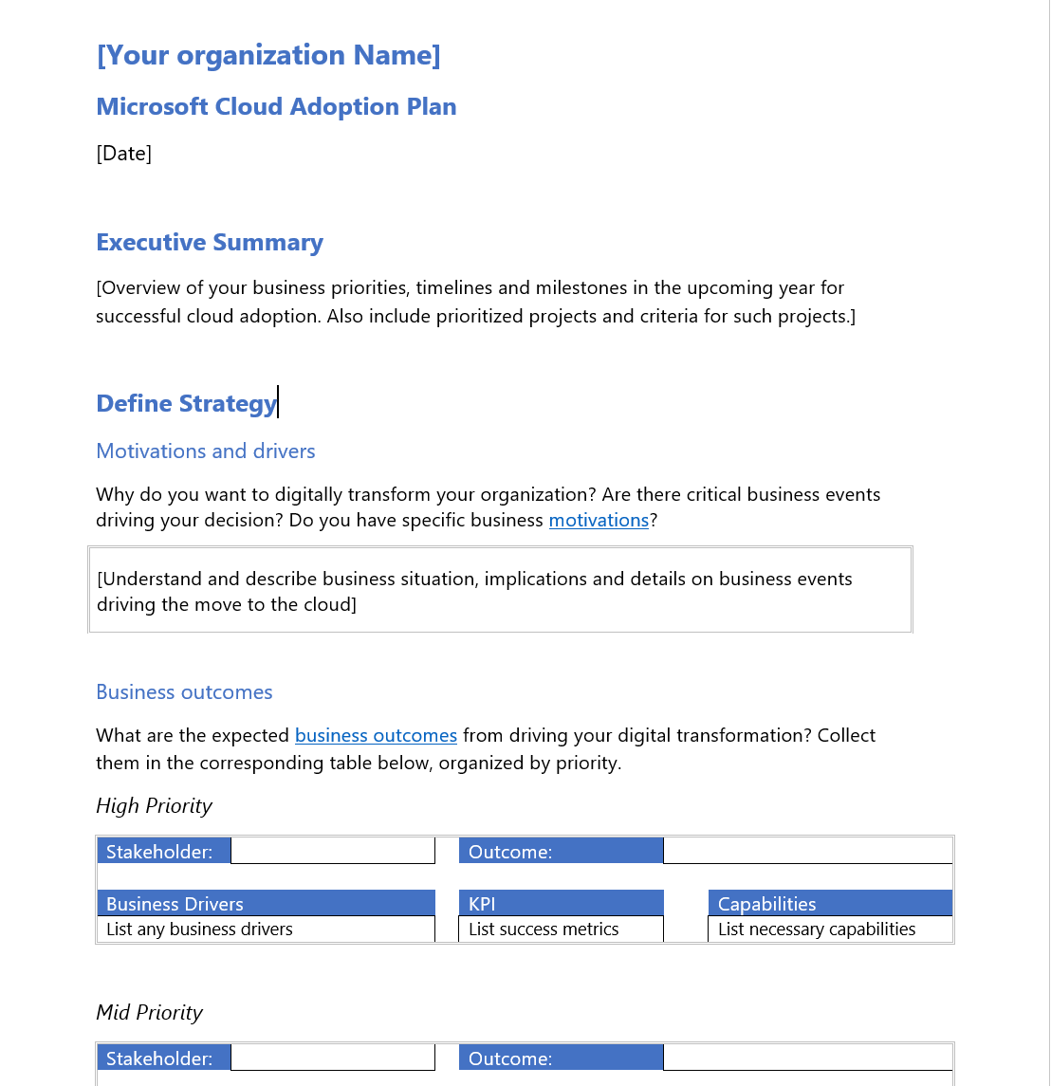
Strategy and Plan template
The Strategy and Plan template converts the aspirational goals of the cloud adoption strategy into an actionable plan
All the cloud teams leverage the cloud adoption plan to guide technical efforts, in alignment with business outcomes.
Download the template and get started with creating your plan.

Slide 67
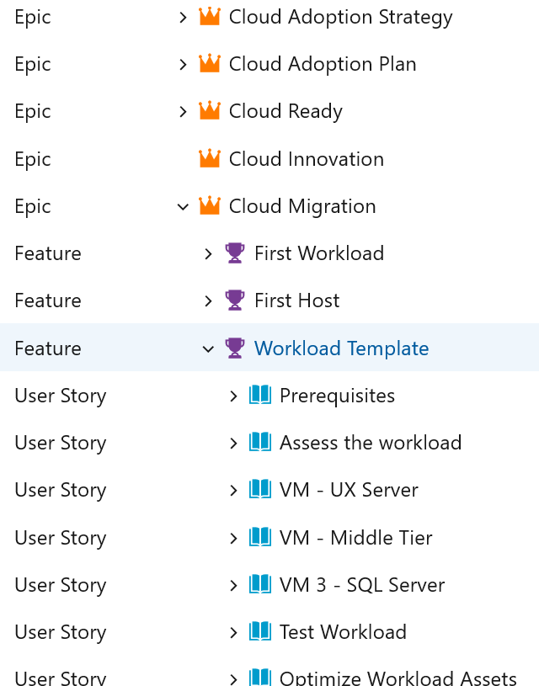
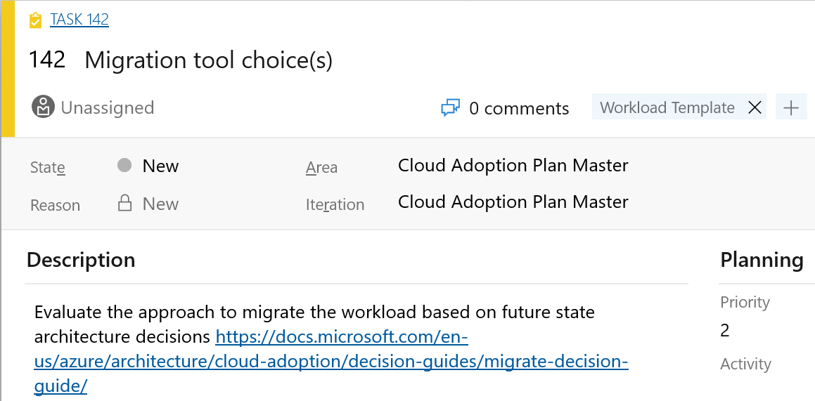
Azure DevOps cloud adoption plan generator
Leverage Azure DevOps to log and track your cloud adoption plan: aka.ms/adopt/plan

Slide 68

Task 3 Create your cloud adoption plan
Example:
How are you organizing your people and teams for cloud transformation?
Where does accountability reside for application creation and availability?
What are the current skills gaps?
How do your people train and skill up?
What is the prioritized list of applications you are moving to the cloud?

Slide 69
Microsoft Cloud Adoption Framework for Azure
Proven business and technical guidance to help customers create and implement the business and technology strategies necessary to succeed in the cloud
Define strategy
Define business justification and expected outcomes
Plan
Align actionable cloud adoption plan to business outcomes
Ready
Prepare people, process and environment for change
Adopt
Migrate or Innovate
Implement desired changes across IT and business processes
Govern
Comply, control and secure
Manage
Operate and optimize
Notes:
<Key point>: The Ready stage of the Microsoft Cloud Adoption Framework involves preparing organizations’ people, process and environment for digital transformation.
We want to enable customers to successfully adopt the Azure cloud.
When we’re talking about cloud adoption and landing zones, we’re pointing to the Ready stage.
In the Ready stage, cloud adoption plans have been discussed and defined, and we are ready to deploy a workload on Azure.
<Transition>: Let’s look at Azure landing zones in more detail.

Slide 70




How do you get started?
W
W
W
W
W
W
W
W
W
W
W
W
Cloud Operating Model
W
Distributed Operations
W
W
W
W
Enterprise Operations
W
W
Central Operations
W
W
Workload
Landing Zones
Decentralized Operations
Platform Foundation
Notes:
<Key point>: Platform Development Velocity can be implemented in two ways.
With iterative implementations, customers are more tentative, and more deliberate in learning process. They want to start small, grow, and learn as they grow.
With a rich initial implementation, customers are more mature. They are looking for a robust implementation from day one.
[Go through options for each implementation]
[Call out short links on CAF landing zone documentation and ARM templates for customers’ next steps (GitHub documentation).
<Transition>: Let’s look at the Cloud Operating Model in more detail.

Slide 71
Azure landing zones
Notes:
Azure landing zones in the Microsoft Cloud Adoption Framework for Azure are designed to accelerate efforts to map, modernize, or even reimagine the operating model. Azure landing zones help build a cloud environment aligned to the optimal technology operations specific to your needs in the cloud.

Slide 72



What are you going to build?
A house
A stadium
A bridge
Notes:
<Key point>: Deciding what you’re going to build will drive what foundation to choose.
Each of these buildings requires a different foundation.
<Transition>: What foundation is the right one?

Slide 73
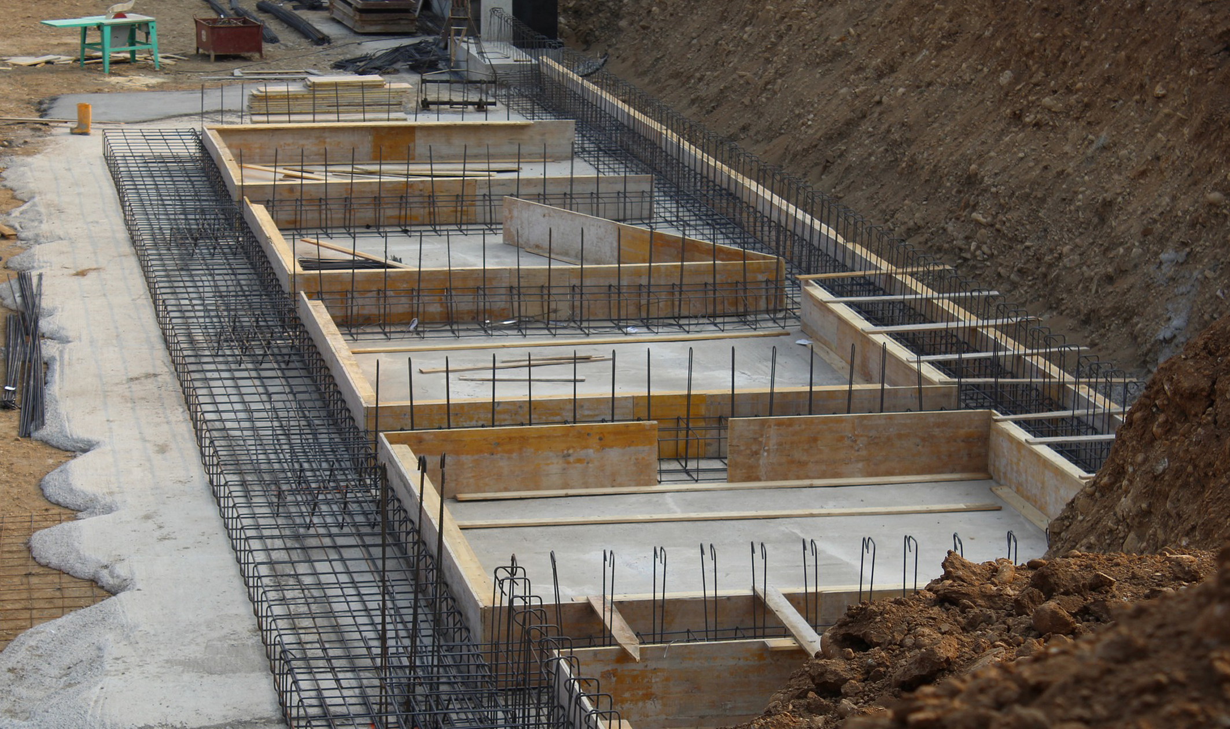


All foundations are NOT created equal
A house
A stadium
A bridge
Notes:
<Key point>: The foundation selection depends on what you’re building.
Foundations will be tailored to the construction of what’s being built above it.
<Transition>: Choosing the right structural foundation is like choosing the right cloud foundation.

Slide 74





The value of creating cloud-ready environments
Aligned to business priorities
Cloud-design considerations
Adapted for cloud operating model
Ready for cloud applications
Adaptable to grow and expand
Compliant
Agile
Cutting-edge innovation
Secure
Notes:
<Key point>: Constructing a cloud-ready environment is like building a house structurally up to code.
If a customer wants to build an app in the cloud, we must build the environment that helps them deliver on their business priorities.
What is the cloud operating model that is running the application?
We must ensure that the environment scales as the application becomes more robust and more complex.
And of course, the cloud environment must be compliant.
Cloud-ready environments help customers to become agile, make use of innovative technologies, and remain secure.
<Transition>: Let’s look at how Azure landing zones help customers.

Slide 75
Landing zones What is their purpose?
Landing Zone (Subscription)
The purpose of a “landing zone” is to ensure that when a workload lands on Azure, the pre-provisioned landing zone environment is already in place to manage your cloud estate.
Landing zones ensure that your workload deployments have baked-in guardrails for agility and maintain compliance with enterprise security and governance requirements.
Roles e.g. NetOps, SecOps, DevOps
IAM
Management & Monitoring
Metrics, Logs, and Alerts
Security Center
Subscription Policy e.g. allowed resource providers
Encryption at-rest
No Public IP
Policy
Application
Application
Application
Application
App Resources (VM, DB, Storage)
Cost Management
IAM
Policy
Application Template
Keys
Monitor
Azure Monitor
Shared Services e.g. Active Directory (IaaS)
Inbound and Outbound
Corp Connectivity
Intra and Inter Landing Zone
Shared Services
Networking
Network Watcher
Security Center

Slide 76

Azure Landing Zones | Design Areas
Enterprise Enrollment
Identity
Resource Organization
Network Topology & Connectivity
Business Continuity & Disaster Recovery
Governance disciplines
Deployment options
Operations baseline
Notes:
<Key point>: Design areas are the critical components of Azure landing zones.
Remember the foundation we’re choosing? And how it depends on what house we are building?
Foundations for house construction have common attributes but have their own specific components—and the cloud environment is similar.
[Set up slide] These are the design components that all Azure landing zones must have.
[Go through each design area]
Thinking about how to deploy and how to manage landing zones, Deployment options and Operations baseline are critical to the Manage stage.
<Transition>: Let’s look at how we get started with Azure landing zones.

Slide 77
How do we get started?
Platform Development Velocity
Cloud Operating Model
Notes:
<Key point>: There are two main components to Azure landing zones—Platform Development Velocity and the Cloud Operating Model.
Now we understand the design components in Azure landing zones. How do we get started? How do we get our customers started?
Platform Development Velocity is how fast the customer can, or wants, to develop necessary skills to efficiently manage their cloud platform.
The Cloud Operating Model is the operating model for the entire cloud environment, including landing zones and workloads planned for deployment.

Slide 78

How to get started? Platform Development Velocity
Azure Landing Zones
Foundation blueprint
Iterative implementation
Migration blueprint
Terraform modules
Rich initial implementation
Enterprise-scale Landing Zones
https://aka.ms/adopt/landingzone/cafmigrate
https://aka.ms/adopt/landingzone/caffoundation
https://aka.ms/adopt/landingzone/terraform
https://aka.ms/adopt/landingzone/enterprise-scale
Notes:
<Key point>: Platform Development Velocity can be implemented in two ways.
With iterative implementations, customers are more tentative, and more deliberate in learning process. They want to start small, grow, and learn as they grow.
With a rich initial implementation, customers are more mature. They are looking for a robust implementation from day one.
[Go through options for each implementation]
[Call out short links on CAF landing zone documentation and ARM templates for customers’ next steps (GitHub documentation).

Slide 79
What is Enterprise-scale?

Slide 80



Key Challenges
Architecture Complexity: Customers lack the required level of understanding and experience on Azure. The mismatch between on-premises infrastructure and cloud-design considerations creates dissonance and friction with respect to defining architectures and standards for their migration to the cloud. They are struggling with the translation of their requirements to Azure concepts, capabilities, constructs and security model.
Operating Compatibility: Existing approaches and functions for the traditional delivery and management of IT services are not compatible with the Azure platform and cloud operating models. When combined with a lack of skills and experience, customers are struggling to define and therefore transform their operating model to manage and support large-scale cloud infrastructure.
Lack of Trust and Desire for Control: The absence of a precise and detailed cloud architecture that is compliant with their requirements, and the lack of a well-defined operating model to support such a platform, leads IT not to trust Azure and instead strive to maintain full control. This often involves building ‘walls’ and complicated processes which ultimately get in the way of business lines adopting Azure.
Notes:
In working with our customers and partners we have received feedback from some of the challenges they face. When starting with Azure but being accustomed to Traditional IT Architecture the Cloud model can get lost in translation between Technology concepts, security models, and IT management processes. On top of the architectural challenges there are challenges with operating models. Traditional delivery and management of IT services is not compatible with cloud operating models. Lastly our Customers and partners have a desire for Control of their could environment and precise and compliant platform that generates trust.

Slide 81

Metropolis
Using an analogy, this is similar to how city utilities such as water, gas, and electricity are accessible before new houses are constructed. In this context, the network, IAM, policies, management, and monitoring are shared 'utility' services that must be readily available to help streamline the application migration process.
Notes:
TALK TRACK:
One of the best analogies for understanding a landing zone, is to compare it to the necessary services upon which a city is built. Before buildings can be erected and people move into them essentials services must be in place. Road are necessary for people to move around, water and sewer facilities need to be in place, power and gas lines must be made available. You can think of a landing zone as the essential services required for the different types of applications you will host on Azure. Different applications may require different services, and guardrails, and therefore will live in different landing zones. Similar to zoning codes in real life.
One of the major shifts for a centralized IT organization in this scenario is to move from providing all the infrastructure (building for people to live in) to providing the zoning guides (guardrails to be in place for other business units to build their infrastructure and application upon).
One of the main benefit of the cloud is that you can scale resources based on demand and the there is practically no limit on scale. The same applies for scaling down. Just like you turn on light bulbs when you need it and turn it off when you do not , and you are charged only for the portion of electricity when the light bulb is turn on, you can turn on any VM, resources, IOT or any other resources when you need it and turn it off when you do not . Azure give you better option than turn on and off button, imagine a Dial on light bulb and keep adjusting for the light needed indoor during daytime or night when light keep changing because of sunlight or cloud. There is practically no capital cost associated with IT in the cloud because you are not buying hardware to build data center. You are using everything and anything on demand based on need.
Because of this power of unlimited scale, governance problem arises. Due to sheer number of resources, governance and organization of resources become challenge. After all we like to make our and other lives easier, so we think about solving this problem of governance.
I would like you Imagine a library with a pile of books with no marking and sorting and section and you have to find your particular book, it will be difficult, almost impossible.
The same applies to resources in Azure subscription if its not properly organized and not organized for operational efficiency.
Enterprise scale is the answer to organizing subscription to landing zone. We build landing zone so we would know where to go and provision resources when we need them. Just like in a library when we pick up a book , we know where to go to find it or to place it.
Landing zones help with the adoption of cloud and give you a better way of organizing resources not just its type, but by organization, cost and security.

Slide 82
Enterprise-scale?
Enterprise-scale is an architecture approach and reference implementation that enables effective construction and operationalization of landing zones on Azure, at scale and aligned with Azure Roadmap and Microsoft Cloud Adoption Framework for Azure.
Authoritative Provides holistic design decision framework for Azure Platform.
Proven
Based on success of large-scale migration projects at-scale.
Prescriptive Apply it on clearly plan and design your Azure environment.
Enterprise-scale Architecture:
Enterprise-scale design principles: Principles to help/guide you customize the design.
Enterprise-scale design guidelines: Guidelines (decisions and recommendations) for the 8 components of the enterprise-scale architecture
Enterprise-scale Implementation guide: The way you create those things using reference implementation in GitHub and the deployment pipeline
Enterprise-scale Reference Implementation:
Enterprise-scale foundation: A reference implementation of shared services containing network, security, identity, governance services required to construct and operationalize an enterprise-scale landing zone
Enterprise-scale landing zone(s): A reference implementation of a workload environment conforming to the enterprise-scale architecture (opinionated way to implement, code)
Notes:
Enterprise-scale comes in two buckets
The Architecture – What must be true? This is our Microsoft opinion on what should be done based on really world work with our strategic customers.
The reference implementation – This is a first partner example on how this could be implemented. You do not have to use this reference implementation if you are following the design guidelines and principles.
In the rest of the session, we’ll discuss these 5 elements.

Slide 83
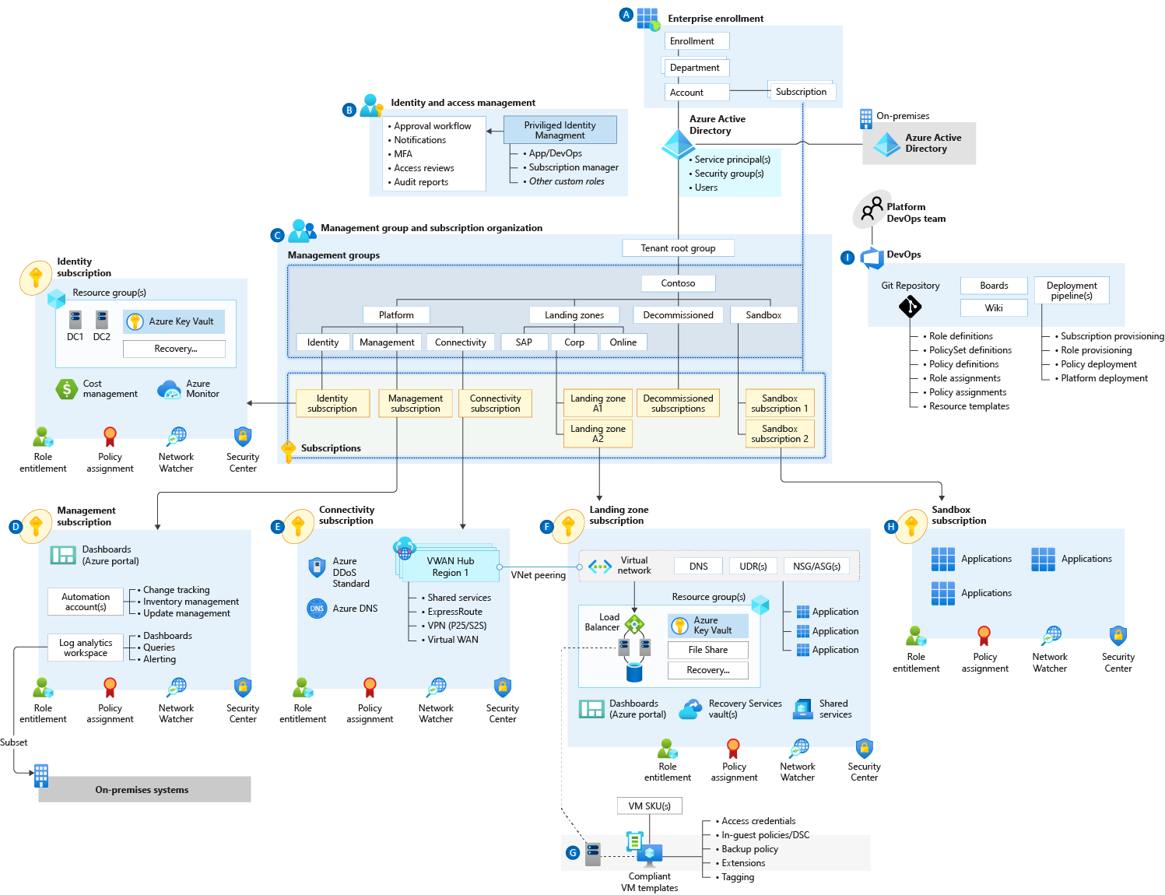
Enterprise-scale
Notes:
Enterprise-scale is an architecture approach and reference implementation that enables effective construction and operationalization of landing zones on Azure, at scale and aligned with the Azure roadmap and the Microsoft Cloud Adoption Framework for Azure. The enterprise-scale architecture provides prescriptive guidance coupled with Azure best practices, and it follows design principles across the critical design areas for the customer's Azure environment.

Slide 84
Enterprise-scale landing zone(s) The principle purpose of the “Landing Zone” is therefore to ensure that when an application or workload lands on Azure, the required “plumbing” is already in place, providing greater agility and compliance with enterprise security and governance requirements.
Notes:
The CAF enterprise-scale landing zone architecture represents the strategic design path and target technical state for the customer's Azure environment. It will continue to evolve in lockstep with the Azure platform and is ultimately defined by the various design decisions the customer organization must make to define their Azure journey.

Slide 85
Task 4 Understand ESLZ Design Principles and build your landing zones

Slide 86
Microsoft Cloud Adoption Framework for Azure
Proven business and technical guidance to help customers create and implement the business and technology strategies necessary to succeed in the cloud
Define strategy
Define business justification and expected outcomes
Plan
Align actionable cloud adoption plan to business outcomes
Ready
Prepare people, process and environment for change
Adopt
Migrate or Innovate
Implement desired changes across IT and business processes
Govern
Comply, control and secure
Manage
Operate and optimize
Notes:
<Key point>: The Ready stage of the Microsoft Cloud Adoption Framework involves preparing organizations’ people, process and environment for digital transformation.
We want to enable customers to successfully adopt the Azure cloud.
When we’re talking about cloud adoption and landing zones, we’re pointing to the Ready stage.
In the Ready stage, cloud adoption plans have been discussed and defined, and we are ready to deploy a workload on Azure.
<Transition>: Let’s look at Azure landing zones in more detail.

Slide 87




Adopt migration execution
Migrate
Migration waves (releases)
Plan, Ready, and Adopt establish repeatable processes for iterative change management and digital transformation. Those processes establish waves of workload migrations (releases in agile terms).
Plan
Ready
Adopt
Migration effort (iterations)
Assess workloads
Assess each batch of workloads to evaluate cost, architecture, and deployment tooling.
Deploy workloads
Replicate functionality in the cloud using IaaS, PaaS, cloud-native, or other modernization solutions.
Release workloads
Test, optimize, document, and review. Release by handing off for governance, management, and security.
Assess each workload and finalize architectural decisions about migration options.
Initiate the migration of the environment using native tools, third-party tools, and project management tools.
Workloads should be tested, optimized, documented, and released for ongoing operations.
Review the migrated workloads and hand them off to governance, operations management, and security teams for ongoing support of those workloads.
https://aka.ms/adopt/migrate
Notes:
<Key point>: The migration process begins with an iterative Assess-Deploy-Release cycle that’s repeatable and predictable.
[Go over each point for Assess-Deploy-Release.]
[Review bullet points.]
<Transition>: Let’s look at templates, tools, and assessments in the Microsoft Azure Cloud Adoption Framework.

Slide 88


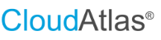
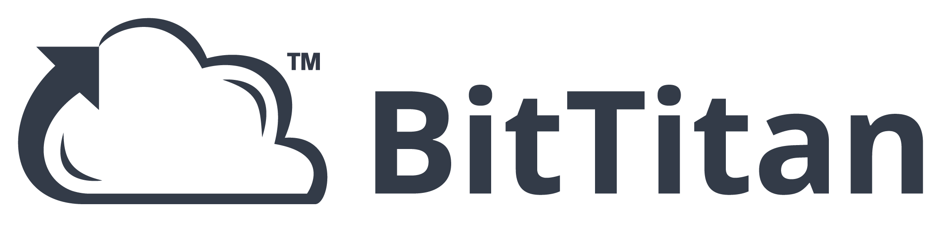
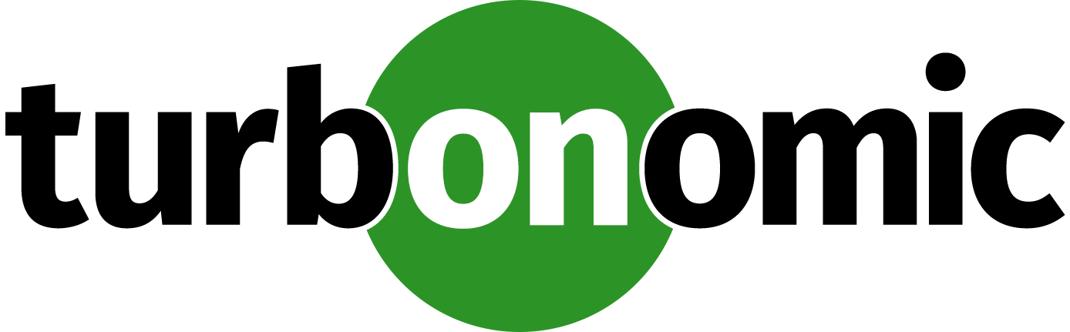

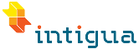
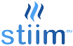



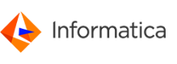
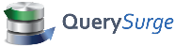
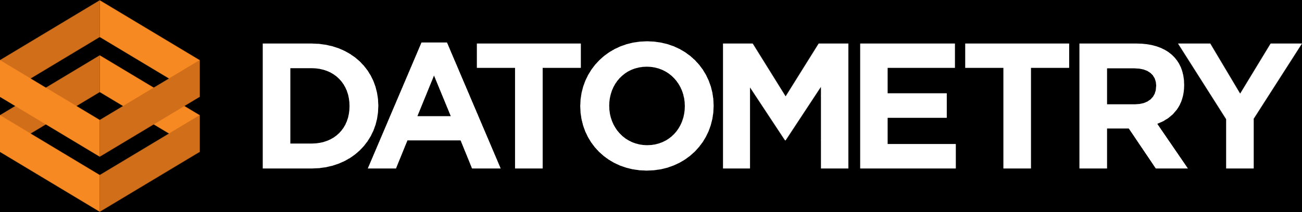
Migration tooling options
Assess workloads
Deploy workloads
Release workloads
Azure Migrate
Data Migration Assistant (DMA)
Azure Database Migration Service
Azure Cost Management
SQL Server Migration Assistant (SSMA)
Azure Data Box
Azure Advisor
Azure Monitor
Azure Security Center
ISV solutions (as needed)
Notes:
<Key point>: Make use of Microsoft and third-party tools in each phase of migration releases to ensure a successful Azure migration.
Call out the free Microsoft tools in the Azure portal.
And the third-party (ISV) tools to help support your migration requirements.
[Briefly skim over third-party offerings for migration tools].
We’re working closely with solution partners to build a consistent experience across Azure and third-party tools.
<Transition>: Let’s look at what Azure Migrate offers for migration initiatives.

Slide 89
Migration patterns | The five Rs of rationalization
What | Rehost | Refactor | Rearchitect | Rebuild | Replace
 | ls known as a lift and shift migration, a rehost effort moves a current state asset to the chosen cloud provider, with minimal change to overall architecture. | Refactoring code to enable an application to deliver on new business opportunities and fit a PaaS-based model. | Aging applications that aren't compatible with cloud providers might need to be rearchitected before transformation. Some applications might be more cost effective as cloud native solutions. | In some scenarios, the delta that must be overcome to carry an application forward can be too large to justify further investment. In this case, a new code base is created to align with a cloud-native approach. | Sometimes software as a service (SaaS) applications can provide all the necessary functionality for the hosted application.
Common drivers might include: | Reducing capital expense Freeing up datacenter space Achieving rapid return on investment in the cloud | Faster and shorter updates Code portability Greater cloud efficiency (resources, speed, cost, managed operations) | Application scale and agility Easier adoption of new cloud capabilities Mix of technology stacks | Accelerate innovation Build apps faster Reduce operational cost | Standardizing around industry-best practices Accelerating adoption of business process-driven approaches Reallocating development investments into applications that create competitive differentiation or advantages
Learn more: digital-estate/5-rs-of-rationalization
Notes:
<Key point>: Cloud rationalization evaluates assets to find the best way to migrate / modernize assets in the cloud.
The five Rs of rationalization are effective in identifying a potential future state for any workload that’s considered as a cloud candidate.
<Transition>: Let’s look at how migration tooling expands options for workload architectures.

Slide 90

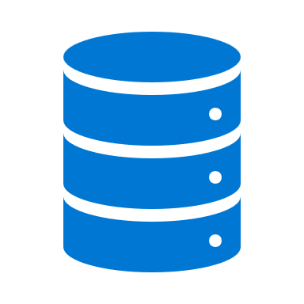




Migration tooling options
Assessment of an LOB Workload (N-tier App & Data)
Bandwidth Analysis
Storage: Data Box – Offline Transfer
Storage exceeds available bandwidth
Azure Storage
Re-hydrate from Azure Storage
Modernize App & Data
Yes
LOB App
Yes
App & Data: Refactor Pipeline/Re-Deploy
Refactor & Modernize
Expand workload architecture options with broad tooling options.
Dedicate VMs
Yes
Existing DevOps Pipeline
Azure App Service
App: App Service Migration Tool & Data: Azure Migrate – Database Migration
Migrate app and data to IaaS with no changes to the current state
No
Azure SQL (MI)
Hundreds of Apps per VM
LOB App
Innovation Potential
Migration is more than a lift and shift rehost to IaaS using tools like Azure Site Recovery.
Modernize some assets during migration with PaaS focused solutions like Database Migration Service.
Over time, refactor and modernize any workloads that represent innovation potential.
Yes
App & Data: Refactor Pipeline/Re-Deploy
Modernize Data Only
Yes
Existing DevOps Pipeline
Azure IaaS
App: Azure Migrate – Server Migration & Data: Azure Migrate – Database Migration
No
Azure SQL (MI)
Migrate app and data to IaaS with no changes to the current state
LOB App
Data Platform Analysis
Simple Data Platform
App: Azure Migrate – Server Migration & Data: Azure Migrate – Server Migration
Azure IaaS
Azure IaaS
Complex Data Platform: Cluster, High-Availability, Always On, etc.
LOB App
App: Azure Migrate – Server Migration & Data: Build New or Extend Hybrid Cluster – Synchronize data until promotion
Azure IaaS
Azure IaaS
Notes:
<Key point>: Multiple migration tooling options are available, depending on the architecture of on-premises workloads.
Communicate Azure migration solutions beyond simple rehosting (lift and shift).
Highlight tools and other deployment options.
<Transition>: Let’s look at Azure Migrate’s other useful functionalities.

Slide 91
Azure Migrate: a central hub for datacenter migration
Multiple scenarios
Migrate Windows and Linux Servers, Databases, Data, Web Applications and Virtual Desktops
Diverse capabilities
Comprehensive discovery, assessment, and migration capabilities powered by Azure and third-party tools
Centralized visibility
Centralized migration repository delivering end-to-end tracking and insights
Notes:
Azure Migrate is Microsoft’s most comprehensive first party migration service. It provides a hub of tools to Discover, assess, and migrate on-premises applications, infrastructure, and data. Centrally plan and track the migration across multiple Microsoft and independent software vendor (ISV) tools. Azure Migrate acts as an intelligent hub, so it provides recommendations and insights to move you along your migration journey based on your project and datacenter environment. And the service is free to use with an Azure subscription, no licensing cost required,

Slide 92
Common migration scenarios
Notes:
[Title slide]

Slide 93


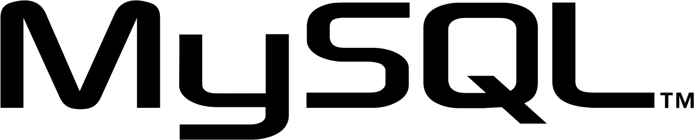
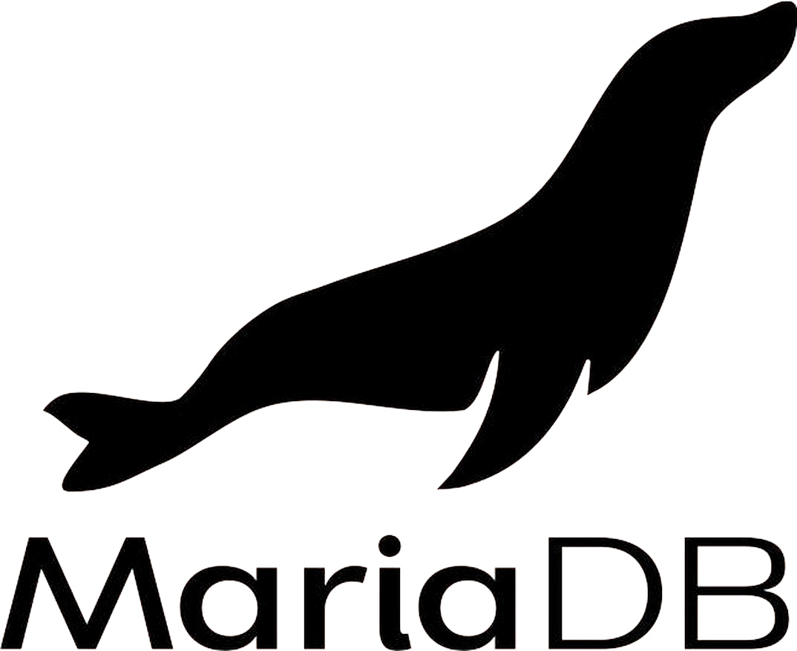

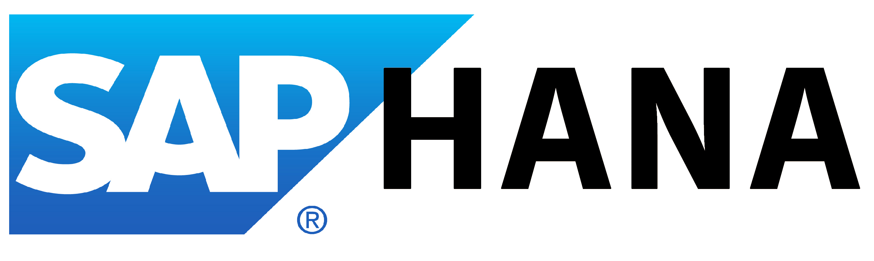

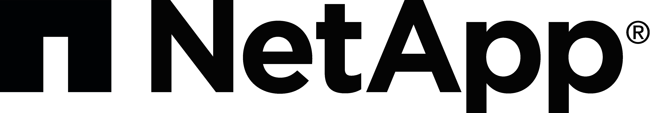



Common migration projects
Windows Server
SQL Server
Linux & Open source databases
Dev/test workloads
ASP.NET/PHP web apps
SAP
Specialized workloads
VDI workloads
Notes:
<Key point>: Here are some examples of common migration projects and associated workloads.
A customer’s environment might also have multiple workloads.
It’s important to understand all workloads in the migratable estate to address any requirements of specialized workloads, etc.
<Transition>: Lets' look at migrating VMware-virtualized apps to Azure VMware Solutions next.

Slide 94


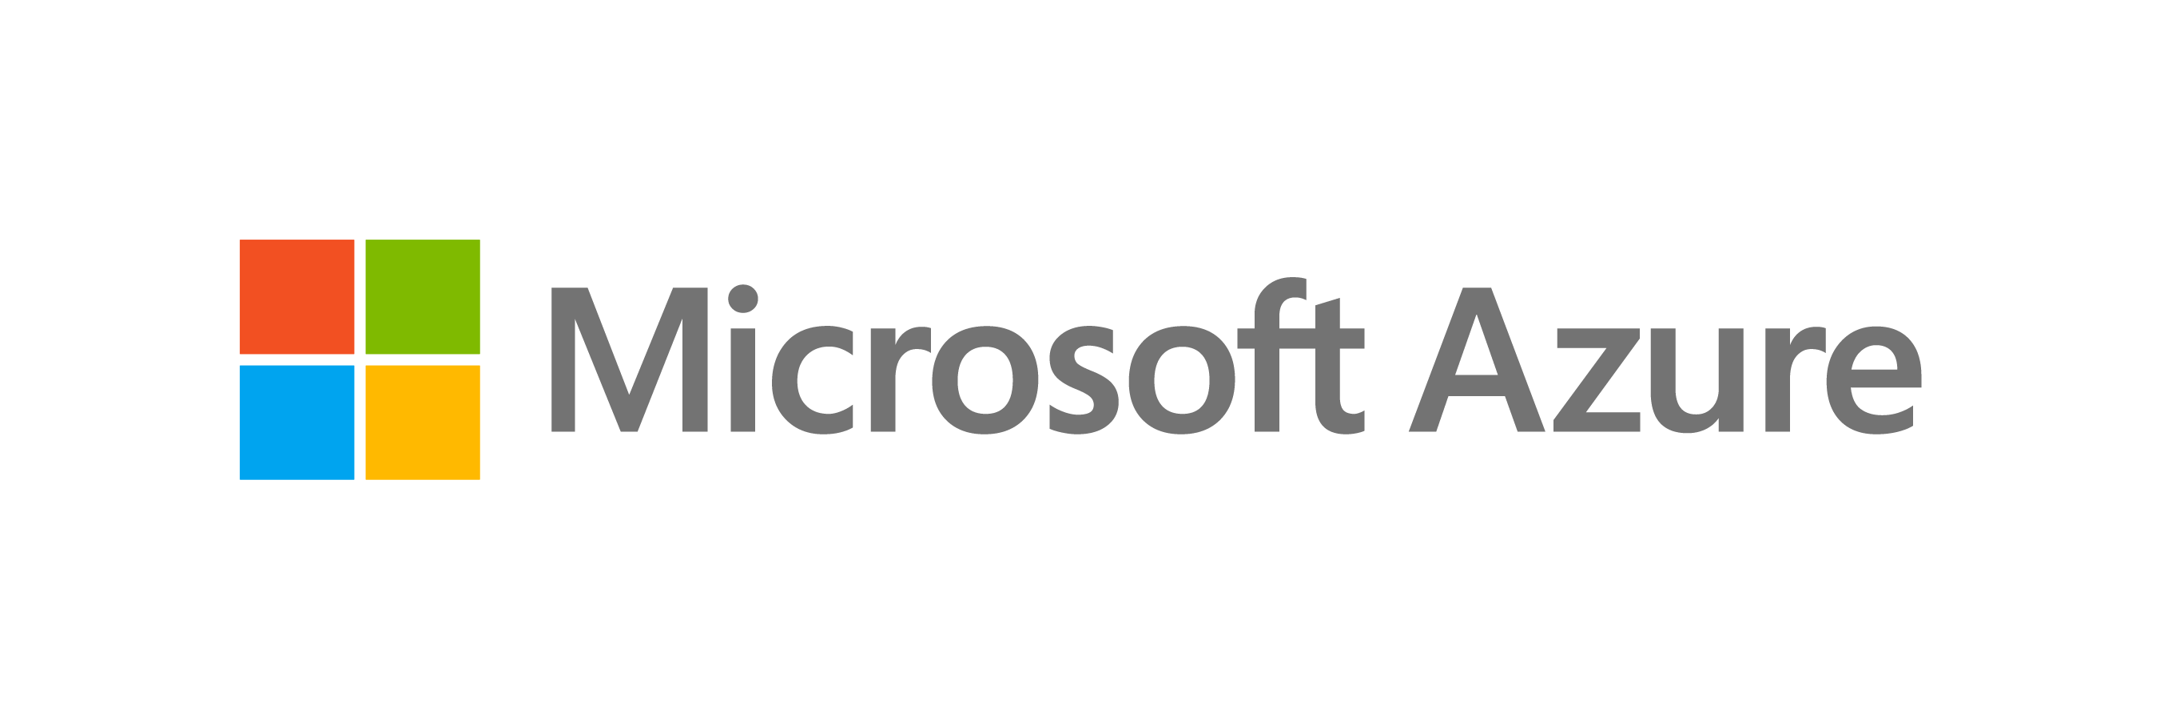
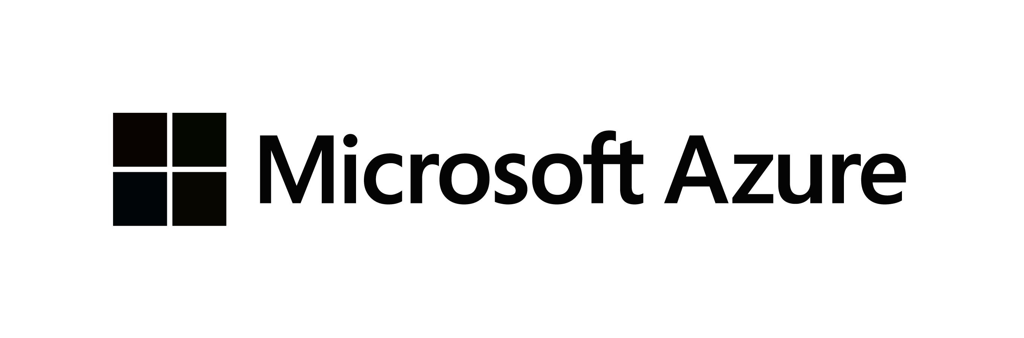
Migrating your workloads to Azure IaaS
LOB App
LOB App
Web/App layer
Azure IaaS
Azure Migrate
Server Migration
Data layer
Azure IaaS
VMware
AWS
Google Cloud

Slide 95
Migrating your VMware-virtualized infrastructure to Azure VMware Solution
LOB App
LOB App
Web/App layer
Web/App layer
VMware tools
Data layer
Data layer
VMware
Azure VMware Solution

Slide 96
Migrating your Virtual Desktop Infrastructure (VDI) to Azure Virtual Desktop
VDI Deployment
VDI Deployment
Azure Migrate (Integration with Lakeside for Assessment) Partner tools for Migration
Virtual Desktops (RDS/VMware/Citrix)
Azure Virtual Desktop (native or VMware/Citrix)
VDI Infrastructure
Azure IaaS
VMware
AWS
Google Cloud

Slide 97

Modernizing your .NET applications to Azure App Service & Azure SQL
LOB App
LOB App
Web/App layer (.NET)
Azure App Service
Azure Migrate Server Migration
Data layer
Azure SQL
Azure Migrate Database Migration
VMware
AWS
Google Cloud

Slide 98

Best practice: cost-optimize migrated workloads
Before Migration
After Migration
Estimate monthly workload costs
Right size VMs
Select the right storage
Take advantage of Azure Hybrid benefits
Use reserved VM instances
Aggregate cloud spend across subscriptions
Use Azure Cost Management
Monitor resource utilization
Implement resource group budgets
Optimize Azure Monitor retention
Optimize storage
Automate VM optimization
Implement serverless technologies
Use Logic Apps and runbooks with Budgets API
Notes:
<Key point>: It’s essential to use best practices when cost-optimizing your workloads on Azure, before and after migration.
[Review best practices recommendations under headings: Before Migration and After Migration.
<Transition>: Let’s look at best practices about scaling a migration on Azure.

Slide 99
Govern and manage migrated workloads
After a successful workload migration, the adoption team should hand off to governance and operations teams to ensure the workload is well-governed and optimized.
Migration waves
Define strategy
Plan
Ready
Adopt
Govern
Manage
Notes:
<Key point>: It’s important to use best practices for workloads during the ‘Govern’ and ‘Manage’ phases.
[Review best practices recommendations.]
<Transition>: Let’s look at the next steps you can take to accelerate your digital transformation.
.

Slide 100
Task 5 Evaluate migration options

Slide 101
Microsoft Cloud Adoption Framework for Azure
Proven business and technical guidance to help customers create and implement the business and technology strategies necessary to succeed in the cloud
Define strategy
Define business justification and expected outcomes
Plan
Align actionable cloud adoption plan to business outcomes
Ready
Prepare people, process and environment for change
Adopt
Migrate or Innovate
Implement desired changes across IT and business processes
Govern
Comply, control and secure
Manage
Operate and optimize
Notes:
<Key point>: The Ready stage of the Microsoft Cloud Adoption Framework involves preparing organizations’ people, process and environment for digital transformation.
We want to enable customers to successfully adopt the Azure cloud.
When we’re talking about cloud adoption and landing zones, we’re pointing to the Ready stage.
In the Ready stage, cloud adoption plans have been discussed and defined, and we are ready to deploy a workload on Azure.
<Transition>: Let’s look at Azure landing zones in more detail.

Slide 102

Why is governance important?
Who is responsible for monitoring? support? And operations?
Which services should be migrated to Azure?
Transformation
Risk mitigation
What roles & responsibilities must be defined?
What security measures should I consider?
What are the core processes needed for service management?
How do I ensure a balance between innovation, cost and agility?
Maintaining full compliance
Creating better cost visibility and control
Improving security posture
Being agile—to support scale
What organizational changes are needed?
What key capabilities I must develop?
Azure governance building blocks?
Notes:
<Key point>: Governance is important, because it sets a balance between transformation and risk mitigation.
Governance enables the creation of a balance between transformation (evolving your business with digital transformation) and risk mitigation (minimizing risks to business outcomes and performance).
Lets explore the methodology underlying Govern in the Cloud Adoption Framework

Slide 103
Governance methodology overview

Slide 104

Drive cloud adoption efficiency in an iterative governance process – four key exercises to focus on:
Methodology overview
Establish a basic understanding of cloud governance
Methodology overview
Establish a basic understanding of cloud governance
1
1
Governance benchmark
Assess your current state and the future state to get started
2
Initial governance foundation
Begin establishing your governance foundation by implementing a set of governance tools
3
Evolve governance foundation Iteratively add governance controls to address risks
4
Notes:
Focusing on four key exercises, governance helps your organization to develop business and technical approaches—and move towards a cloud governance baseline to efficiently mitigate new business risks common to cloud adoption efforts.

Slide 105


Governance model
Envision an end state – and incrementally build trust and confidence.
Govern
Define corporate policy
Business risks
Document evolving business risks and the business’ tolerance for risk, based on data classification and application criticality
Policy & compliance
Convert risk decisions into policy statements to establish cloud adoption boundaries
Process
Establish processes to monitor violations and adherence to corporate policies.
Five disciplines of cloud governance
Cost management
Evaluate & monitor costs, limit IT spend, scale to meet need, create cost accountability
Security baseline
Ensure compliance with IT security requirements by applying a security baseline to all adoption efforts
Resource consistency
Ensure consistency in resource configuration. Enforce practices for on-boarding, recovery, and discoverability
Identity baseline
Ensure the baseline for identity and access are enforced by consistently applying role definitions and assignments
Deployment acceleration
Accelerate deployment through centralization, consistency, and standardization across deployment templates
Governance funnels corporate policy changes into five actionable disciplines –
enabling your organization to modernize and reach business goals.
https://aka.ms/adopt/Gov
Notes:
Corporate governance policies are formulated to detect potential problems.
The five disciplines of governance are actionable—and are rolled out in governance iterations.
They help your organization manage risks—and create guardrails for your cloud adoption effort.
Using actionable, efficient, and comprehensive guidance, your organization can modernize, while achieving your business outcomes.

Slide 106
Governance – develops and evolves corporate policies for:
Resource consistency and management
Security baseline
Identity baseline
Cost management
Deployment acceleration
Cloud governance team
A team consisting of cloud architects, legal, security and/or HR & Finance develops and enforces these disciplines across your organization to ensure governance consistency.
Notes:
Governance develops and evolve corporate policy along five disciplines. A cloud governance team is tasked with in an incremental process of mitigating risks to business processes and technology platform with minimal interruption to cloud adoption and innovation.

Slide 107
Cloud governance team

Slide 108
Cloud governance team
A cloud governance team evaluates and manages risk tolerance, identifies high-risk areas for business, and converts risks into governing corporate policies.
Cloud governance team functions
Determine necessity of cloud governance team.
Align with other teams to:
Review your company's strategy and plan template with members of the cloud strategy team to understand motivations, metrics, and strategy.
Review your company's cloud adoption plan template with members of the cloud adoption team to understand timelines and prioritization.
Review the operation team's operations management workbook to understand the operational requirements and commitments that have been established with the business.
Establish cadence with teams that aligns with:
Release and planning cycles.
The cloud strategy team to review risks of the next wave of adoption and gauge the team's level of tolerance for risks.
Review and iterate.
Ensures cloud-adoption risks and risk tolerance are properly evaluated and managed.
Identifies risks that can't be tolerated by the business, and it converts risks into governing corporate policies.
Notes:
Comprehensive governance is a cross-team initiative involving cooperation and alignment across business outcomes, measurements, and strategy.
The Cloud governance team is responsible for evaluating and managing risk tolerance and creating policies from perceived business risks.

Slide 109
Cloud governance team
A cloud governance team evaluates and manages risk tolerance, identifies high-risk areas for business, and converts risks into governing corporate policies.
Cloud governance team functions
Review Govern module of Cloud Adoption Framework (methodology, approach, and implementation).
Complete the governance benchmark to assess your governance needs and priorities.
Implement the governance MVP approach (initial governance best practice and configuration) that best fits your organization’s needs.
Continuously improve governance maturity – align with cloud adoption plan to continue to ensure governance controls guard against changing risks and governance needs.
As landing zones are deployed and expanded, evaluate deployments to ensure adherence to governance guidelines as new risks or governance violations might emerge.
Ensures cloud-adoption risks and risk tolerance are properly evaluated and managed.
Identifies risks that can't be tolerated by the business, and it converts risks into governing corporate policies.
Notes:
A solid governance foundation includes Cost management controls.
Continue your process of governance iterations by implementing Cost management best practices.

Slide 110
Governance as actionable model

Slide 111

Cost management
Establish controls and processes to ensure proper allocation of cost across business units, implement cost guardrails, and analyze the cost of applications.
Azure tools and services
Define
Enterprise Enrollment Hierarchy Process and RACI Azure Cost Management Budgets and Alerts + RACI
Cost Management RBAC Model
Define Cost Management Policies
Tagging
Allowed VM SKUs
Allowed Storage SKUs
Allowed Networking SKUs
Allowed Database SKUs
Azure Policy
Azure Cost Management PBI Application in Azure Marketplace
Azure Advisor
Azure Portal
Azure EA Content Pack

Slide 112
Security baseline
Establish policies to protect your network, assets, and data –
residing on cloud provider platform(s).
Document risks, business tolerance, and mitigation strategies related to the security of:
Data and assets: develop clear, simple, and well-communicated guidelines to identify, protect, and monitor the most important data assets
Network: control and monitor any allowed communication between on-premises environment and cloud workloads.
Implement these best practices for corporate policy:
Network requirements: on-premises networks must be secured against potential unauthorized access from cloud-based resources.
Hybrid identity strategies: a key factor in structuring cloud-based identity services is the level of integration required with existing on-premises identity infrastructure.
Encryption: encryption mechanisms vary in cost and complexity, and both technical and policy requirements and can influence decisions on how encryption is applied and how to store and manage critical secrets and keys
Security Baseline policies: processes that manage updates to security policy based on inputs from stakeholders. (e.g., initial risk assessment and planning, deployment planning and testing, and quarterly review and planning)
Azure tools and services
Azure Policy
Azure Security Center
Azure Sentinel
Subscription Design
Encryption
Hybrid Identity
Azure Networking
Azure Automation

Slide 113
Resource consistency
Implement the foundation for governance best practices –
with correct resource organization.
Azure tools and services
Define Azure Management Groups & Subscriptions model and RACI
To reflect security, operations and business/accounting hierarchies
To group similar resources into logical collections
Define resource consistency roles & responsibilities
To further group applications or workloads into deployment and operations units
Define Resource Consistency Policies
Naming Conventions
Tagging
Allowed Locations
Allowed Resource Types
Allowed Extensions
Auditing
Azure Policy
Azure Monitor
Azure Advisor
Resource Manager Templates
Resource Graph
Management Groups

Slide 114
Identity baseline
Protect your data and assets in the cloud –
implementing identity management and access control.
Azure tools and services
Define Azure RBAC Model
Using RBAC can segregate duties within a team and grant only the amount of access to users that they need to perform their jobs. Instead of giving everybody unrestricted permissions in an Azure subscription or resources, only certain actions with narrow scope can be allowed.
Define Azure Access Management Process and RACI
Several options are available for managing identity in a cloud environment which vary in cost and complexity.
A key factor in structuring your cloud-based identity services is the level of integration required with existing on-premises identity infrastructure.
Operationalize Azure Privileged Identity Management
Cloud-based identity management is an iterative process.
RBAC
Azure AD
Azure AD B2B
Azure AD B2C
Directory Federation
Directory Replication

Slide 115
Deployment acceleration
Establish policies to govern asset configurations or deployments –
manual, or automated through DevOps best practices.
Azure tools and services
The DevOps practices in this discipline include:
Infrastructure as code
Stand up environments in the fastest means possible.
Remove the human element and reliably and repeatable deploy every time.
Improve environment visibility and improve developer efficiency
Store infrastructure definitions alongside application code.
Continuous integration and continuous deployment
Accelerate delivery through automation
Simple and easy to use
Global community for actions
Azure services that enable deployment acceleration include Azure Blueprints
Deploy and update cloud environments in a repeatable manner using composable artifacts
Resource Manager Templates
Azure PowerShell
Azure CLI
Azure Policy
Resource Grouping & Tagging
Azure DevOps
Github – Azure Github Actions
Azure Automation

Slide 116
Define your initial governance state – leverage the Governance benchmark assessment

Slide 117
Drive cloud adoption efficiency in an iterative governance process – four key exercises to focus on:
Methodology overview
Establish a basic understanding of cloud governance
Methodology overview
Establish a basic understanding of cloud governance
1
1
Governance benchmark
Assess your current state and the future state to get started
Governance benchmark
Assess your current state and the future state to get started
2
2
Initial governance foundation
Begin establishing your governance foundation by implementing a set of governance tools
3
Evolve governance foundation Iteratively add governance controls to address risks
4

Slide 118

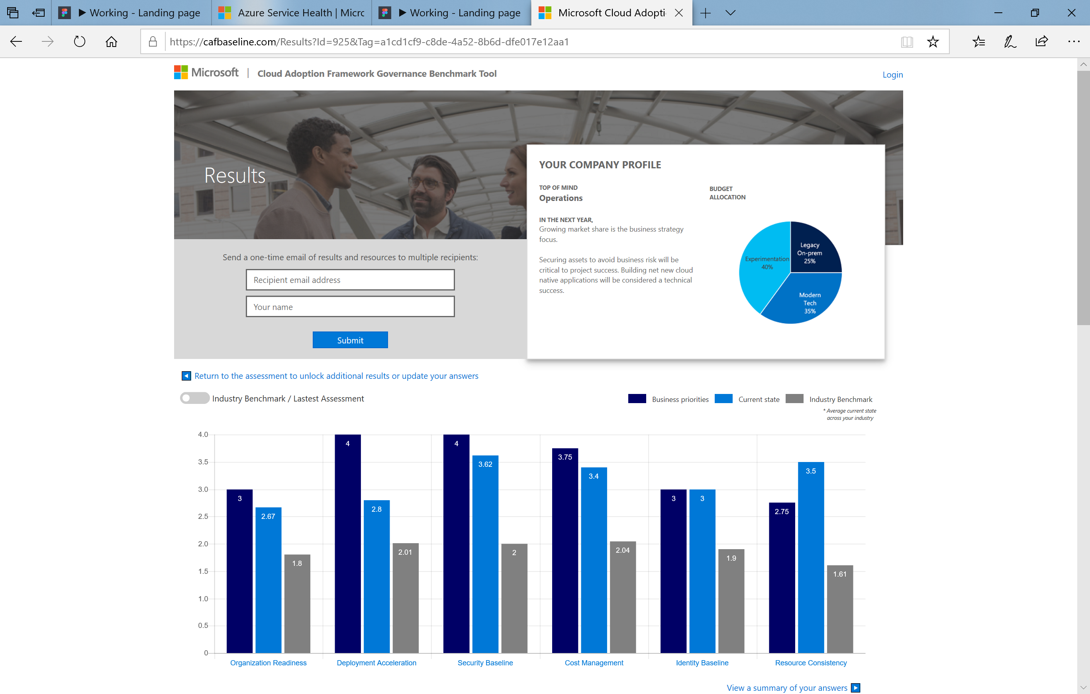
Benchmark your governance state
Make governance actionable with processes and policies. Use the Governance benchmark tool.
Establish a governance baseline and recommended starting-point
Understand gaps between your desired and current governance state, using the Cloud Adoption Framework.
Remove blockers with curated guidance on how to build a proper Governance foundation.
https://cafbaseline.com/

Slide 119
Take action and set up your initial governance foundation

Slide 120
Guard and manage your digital transformation: Mature your governance, security, and compliance strategy, move ahead, and remediate new risk with protected data, critical apps, and cost with just-in-time governance layers.
Methodology overview
Establish a basic understanding of cloud governance
Methodology overview
Establish a basic understanding of cloud governance
1
1
Governance benchmark
Assess your current state and the future state to get started
Governance benchmark
Assess your current state and the future state to get started
2
2
Initial governance foundation
Begin establishing your governance foundation by implementing a set of governance tools
Initial governance foundation
Begin establishing your governance foundation by implementing a set of governance tools
3
3
Evolve governance foundation Iteratively add governance controls to address risks
4

Slide 121

Executing incremental governance
Governance MVP
Establish a foundation that can quickly evolve as cloud adoption and cloud governance mature. Mitigate tangible risks identified in the cloud adoption plan.
Governance MVP
Identity strategy
Security management discipline evolves
Resource management discipline evolves
Cost management discipline evolves
Network & encryption strategy
Update corporate policy… Implement with configuration management changes
Update corporate policy… Implement with configuration management changes
Update corporate policy… Implement with configuration management changes
Configuration strategy & corporate policy implementation
Risk Evolutions
The risk profile will change as you plan additional iterations of cloud adoption. The cloud governance team monitors those adoption plans to identify risks and evolve corporate policy statements.
Risk:
Protected Data
Risk:
Critical Apps
Risk:
Cost
Cloud Adoption Adoption timeline will trigger risks along the journey

Slide 122
Build the governance MVP
Standard enterprise |  | Complex enterprise
Customers or staff reside largely in one geography |  | Customers or staff reside in multiple geographies or require sovereign clouds
Business units share a common IT infrastructure |  | Multiple business units that do not share a common IT infrastructure
Single IT budget |  | Budget allocated across business units and currencies
Capital expense-driven investments are planned yearly and usually cover only basic maintenance |  | Capital expense-driven investments are planned yearly; often include maintenance and refresh cycles of 3-5 years
Datacenter or third-party hosting providers with fewer than five datacenters |  | Datacenter or third-party hosting providers with more than five datacenters
Networking includes no WAN; or 1-2 WAN providers |  | Networking includes complex network or global WAN
Identity is a single forest, single domain |  | Identity consists of multiple forests, multiple domains
Cost Management (cloud accounting) showback model – billing is centralized through IT |  | Cost Management (cloud accounting) chargeback model – billing can be distributed through IT procurement
Security Baseline – protected data: company financial data and IP. Limited customer data. No third-party compliance requirements. |  | Security Baseline (protected data) – Multiple collections of customers' financial and personal data
Notes:
Build a Minimum Viable Product for Governance.
To begin your cloud adoption journey, initially you can implement a Minimum Viable Product (MVP) for governance .
Based on complexity of your environment, either Standard or Complex, there are corresponding guide in Microsoft CAF. Each guide outlines a set of best practices, based on a set of customer experiences, and industry recommendations .

Slide 123
Making Governance Actionable with Azure Native Tools
Cloud Native Tools
Cost Management
Security Baseline
Identity Baseline
Resource Consistency
Deployment Acceleration
Azure Blueprints
Azure Policy
Azure Cost Management
Azure Advisor
Azure Blueprints
Azure Policy
Azure Security Center
Azure Sentinel
Threat Protection
Azure Blueprints
Azure RBAC
Azure AD
Azure AD B2B
Azure AD B2C
Directory Federation
Directory Replication
Azure Blueprints
Azure Policy
Azure Monitor
Change Tracking
DSC
Update Management
Automation
Azure Blueprints
Azure Policy
Resource Tagging
ARM Templates
Azure DevOps
Azure Site Recovery
Azure Backup
Azure Automation

Slide 124
Sample policies: Cost management
Modify CostCenter Tag & its value from Resource Group
Modify CostCenter Tag to Resource Groups
For tracking purposes, all assets must be assigned to an application owner within one of the core business functions.
When cost concerns arise, additional governance requirements will be established with the finance team.
Allowed Azure Region for Resources and Resource Groups​
Allowed Azure VM SKUs

Slide 125
Sample policies: Security baseline
All deployed assets must be categorized by criticality and data classification.
All protected data must be encrypted when at rest.
Network subnets containing protected data must be isolated from any other subnets. Network traffic between protected data subnets is to be audited regularly.
All connections between the on-premises and cloud networks must take place either through a secure encrypted VPN connection or a dedicated private WAN link.
No public facing web site backed by IaaS should be exposed to the internet without DDoS.
Governance tooling must audit and enforce network configuration requirements defined by the Security Baseline team.
Trends and potential exploits that could affect cloud deployments should be reviewed regularly by the security team to provide updates to Security Baseline tooling used in the cloud..

Slide 126
Sample policies: Resource consistency
All deployed assets must be categorized by criticality and data classification.
Subnets containing mission-critical applications must be protected by a firewall solution capable of detecting intrusions and responding to attacks.
Governance tooling must audit and enforce network configuration requirements defined by the Security Management team.
Governance tooling must validate that all assets related to mission-critical apps or protected data are included in monitoring for resource depletion and optimization.
Governance tooling must validate that the appropriate level of logging data is being collected for all mission-critical applications or protected data.
Governance process must validate that backup, recovery, and SLA adherence are properly implemented for mission-critical applications and protected data.

Slide 127
Sample policies: Identity baseline
All assets deployed to the cloud should be controlled using identities and roles approved by current governance policies.
A least-privilege access model will be applied to any resources involved in mission-critical applications or protected data.
Elevated permissions should be an exception, and any such exceptions must be recorded with the cloud governance team. Exceptions will be audited regularly.
All groups in the on-premises Active Directory infrastructure that have elevated privileges should be mapped to an approved RBAC role.
All accounts are required to sign in to secured resources using a multi-factor authentication method.
Deployment of any applications that require customer authentication must use an approved identity provider that is compatible with the primary identity provider for internal users.

Slide 128
Sample policies: Deployment acceleration
All assets deployed to the cloud should be deployed using templates or automation scripts whenever possible.
Key metrics and diagnostics measures will be identified for all production systems and components.
Operations will consider using monitoring and diagnostic tools in nonproduction environments such as Staging and QA to identify system issues before they occur in the production environment.
Cloud governance processes must include monthly review with configuration management teams to identify malicious actors or usage patterns that should be prevented by cloud asset configuration.

Slide 129
Task 6 Define governance model

Slide 130
Microsoft Cloud Adoption Framework for Azure
Proven business and technical guidance to help customers create and implement the business and technology strategies necessary to succeed in the cloud
Define strategy
Define business justification and expected outcomes
Plan
Align actionable cloud adoption plan to business outcomes
Ready
Prepare people, process and environment for change
Adopt
Migrate or Innovate
Implement desired changes across IT and business processes
Govern
Comply, control and secure
Manage
Operate and optimize
Notes:
<Key point>: The Ready stage of the Microsoft Cloud Adoption Framework involves preparing organizations’ people, process and environment for digital transformation.
We want to enable customers to successfully adopt the Azure cloud.
When we’re talking about cloud adoption and landing zones, we’re pointing to the Ready stage.
In the Ready stage, cloud adoption plans have been discussed and defined, and we are ready to deploy a workload on Azure.
<Transition>: Let’s look at Azure landing zones in more detail.

Slide 131
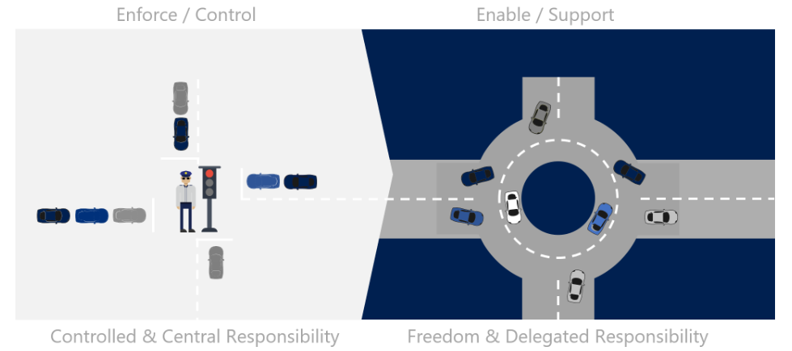
Evolution of the IT Business Model
The cloud is causing a paradigm shift in the function of Operations Management
Notes:
Before the cloud, IT management grew from a simple acquisition function. Acquisition of technical equipment to support business processes required technical expertise and deep experience with a specific group of equipment vendors. IT management consolidated the selection, acquisition, and configuration of IT assets. Generally, the acquired assets included storage, computing power, networking, and other similar assets that are required to power the desired business function. As the primary subject matter experts on the equipment, IT was also tasked with operating the equipment to ensure maximum performance and minimal business disruptions.
When the business builds out new technology solutions, it has a clear need that can justify the significant expenses associated with acquiring assets, or even building out full datacenters. When it builds solutions, the business sees the acquisition costs as an investment in the future. After the business need is met, the perception of the same costs shifts. Costs that are associated with existing solutions are seen as operational drag that's created by past needs. That perception is why many businesses view IT as a cost center. It's also why many IT organizations experience regular cost-control exercises or reductions in IT staff.
Overview Ref: https://docs.microsoft.com/en-us/azure/cloud-adoption-framework/manage/considerations/
Cloud Center of Excellence Ref: https://docs.microsoft.com/en-us/azure/cloud-adoption-framework/organize/cloud-center-of-excellence

Slide 132
Cloud management for cloud adoption efficiency
Establish management baseline
Define the criticality classifications, cloud management tools, and processes
1
Define business commitments
Document supported workloads to establish operational commitments
2
Expand management baseline
Make use of the included best practices based on business commitments and operations decisions
3
Advanced operations and design principals
Use a deeper architecture review to deliver on resiliency and reliability commitments
4
Notes:
With the Microsoft Cloud Adoption Framework, Microsoft recommends different exercises to help organizations develop business and technical approaches for providing cloud management that powers ongoing operations.
To prepare you for this phase of the cloud adoption lifecycle, the framework suggests the following exercises:
Establish a management baseline: Define the criticality classifications, cloud management tools, and processes required to deliver your minimum commitment to operations management.
Define business commitments: Document supported workloads to establish operational commitments with the business and agree on cloud management investments for each workload.
Expand the management baseline: Based on business commitments and operations decisions, make use of the included best practices to implement the required cloud management tooling.
Ensure advanced operations and design principles: Platforms or workloads that require a higher level of business commitment might require a deeper architecture review to deliver on resiliency and reliability commitments.

Slide 133
Methodology to enable cloud management
Cloud operations disciplines
Business alignment
1
Criticality
Establish management baseline
Management
baseline
Inventory and visibility
Operational compliance
Protect and recover
Impact
Enhanced baseline
Platform specialization
Workload specialization
Advanced
operations
Commitment
Expand management baseline
Advanced operations and design principals
Define business commitments
3
4
2
Notes:
The preceding steps create actionable approaches to deliver on the Microsoft Cloud Adoption Framework's Manage methodology. The Microsoft Cloud Adoption Framework guides customers in establishing tooling to enable cloud management across management baselines, business commitments, enhanced management baseline, and advanced operations.

Slide 134
Establish management baseline

Slide 135
Cloud management for cloud adoption efficiency
Establish management baseline
Define the criticality classifications, cloud management tools, and processes
1
Define business commitments
Document supported workloads to establish operational commitments
2
Expand management baseline
Make use of the included best practices based on business commitments and operations decisions
3
Advanced operations & design principals
Use a deeper architecture review to deliver on resiliency and reliability commitments
4
Notes:
Phase introduction slide

Slide 136
Management baseline
Why do you need this?
A well-guided management baseline defines a set of cloud management tools and processes required to deliver your minimum commitment to operations management.
Goals for management baseline
Define the basic tools needed for managing operations around any Azure production environments
Focus on the minimum options and processes necessary instead of all the available options
Use the management baseline to apply resource consistency across different resources on the Azure platform
Notes:
Why we need a management baseline
A well-guided management baseline defines a set of cloud management tools and processes required to deliver your minimum commitment to operations management. It ensures a minimum set of tools and processes that should be applied to every asset in an environment.
Goals for management baseline
With management baselines, you can define the set of basic tools needed for managing operations around any Azure production environment
Focus on the minimum options and processes necessary instead of all the available options
Use the management baseline to apply resource consistency across different resources on the Azure platform

Slide 137
Methodology to enable cloud management
Cloud operations disciplines
Business Alignment
1
Criticality
Establish management baseline
Management
baseline
Inventory and visibility
Operational compliance
Protect and recover
Impact
Enhanced baseline
Platform specialization
Workload specialization
Advanced
operations
Commitment
Expand management baseline
Advanced operations and design principals
Define business commitments
3
4
2
Notes:
The cloud management baseline consists of three basic disciplines for cloud resource management: inventory and visibility, operational compliance, and protection and recovery. These disciplines help organizations accelerate cloud management capabilities by focusing on the minimum options necessary instead of on all of the available options. Let’s drill down into each of the disciplines of a cloud management baseline.

Slide 138
Inventory and visibility
Management baseline
Azure tools and services
Service health
Log analytics
Azure change tracking and inventory service
Azure activity log
Azure monitor for VMs
Azure network watcher
DNS analytics
Create an inventory of assets across multiple clouds, and develop deep visibility into the run state of each asset
Each monitoring tool has been configured with proper access and scope for each operations team
Each asset must be inventoried and classified towards stable operations
Centralization of logging drives reports about change management, service health, and configuration for IT operations
Awareness and understanding of technical changes across multiple workloads is essential for reliable operations
Understand the telemetry about the stability, performance, and operations of the workload, and the assets which support the workload
Inventory and visibility
Management
baseline
Notes:
Consistent management requires an understanding about what is managed (inventory) and how those managed workloads and assets change over time (visibility). Create an inventory of assets across multiple clouds and develop deep visibility into the run state of each asset. Clear insights about inventory and visibility help empower teams to manage the environment effectively.
The first step toward inventory and visibility is to ensure that the responsible parties have access to the right data. Before you implement any cloud-native tools for visibility, ensure that each monitoring tool has been configured with proper access and scope for each operations team.
Before an asset or workload can be managed, it must be inventoried and classified towards stable operations.
Centralized logging is critical to the visibility required every day by the operations management teams. In Azure, that central location is log analytics. The centralization of logging drives reports about change management, service health, configuration, and most other aspects of IT operations.
Awareness and understanding of technical changes across multiple workloads is essential for reliable operations. Any cloud management solution should include a means of understanding the when, how, and why of technical change. Without those data points, remediation efforts are significantly hindered.
To properly maintain commitments, the cloud operations team must first understand the telemetry about the stability, performance, and operations of the workload, and the assets which support the workload.
The Microsoft Cloud Adoption Framework aligns different tools that provide inventory and visibility into the inventory's run state, including:
Service health
Log analytics
Azure change tracking and inventory service
Azure activity log
Azure monitor for VMs
Azure network watcher
DNS analytics

Slide 139
Operational compliance
Management baseline
Establish controls and processes to ensure each state is properly configured and running in a well-governed environment
Azure tools and services
Azure Primitives
Azure automation
Azure update management service
Azure policy
Azure blueprint
Streamline and update management solutions to schedule and control all required updates to be deployed
Ensure policy enforcement across configuration of operating systems, applications, and underlying environments
Get automated compliance for core services to enforce operational compliance in an environment
Effective operational compliance requires consistency:
Established resource consistency with resource organization and tagging
Consistent environment or landing zones enforced through automated tools
Resource configuration consistency with ongoing monitoring and evaluation processes
Updated consistency with scheduling, controlling, and automating necessary updates
Automated remediation to reduce cloud management efforts and increase user satisfaction
Operational compliance
Management
baseline
Notes:
Improving operational compliance reduces the likelihood of an outage related to configuration drift or vulnerabilities related to systems being improperly patched. Operational compliance builds on the discipline of inventory and visibility.
As the first actionable step of cloud management, this discipline focuses on regular telemetry reviews and remediation efforts (both proactive and reactive remediation). Operational compliance helps organizations establish controls and processes to ensure each state is properly configured and running in a well-governed environment.
Streamline and update management solutions to schedule and control all required updates to be deployed.
Ensure policy enforcement across configuration of operating systems, applications, and underlying environments.
Get automated compliance for core services to enforce operational compliance in an environment.
Maintaining compliance with operational commitments requires analysis, automation, and human remediation, but the most effective step that a cloud management team can take toward operational compliance is to establish consistency in resource organization and tagging. When resources are consistently organized and tagged, all other operational tasks become easier.
When landing zones are consistent and enforced through automated tools, it is significantly less complex to diagnose and resolve operational issues.
As it builds on governance and readiness approaches, cloud management should include processes for the ongoing monitoring and evaluation of its adherence to resource consistency requirements.
Any cloud management baseline should include a means of scheduling, controlling, and possibly automating necessary updates. Those updates should include patches at a minimum, but could also include performance, sizing, and other aspects of updating assets.
When a workload commonly encounters issues that can't be resolved through code or architectural changes, automating remediation can help reduce the burden of cloud management and increase user satisfaction.
The Microsoft Cloud Adoption Framework aligns different tools that provide operational compliance, including:
Azure Primitives
Azure automation
Azure update management service
Azure policy
Azure blueprint

Slide 140
Protect and recover
Management baseline
Ensure all managed assets are protected and can be recovered using baseline management tooling
Azure tools and services
Azure Backup
Azure Site Recovery
Protect and recover business critical workloads in the cloud to anticipate and prepare for a potential workload outage
Define plans to back up, protect, and recover your data and VMs in Azure
Get short- and long-term backup without the need to deploy complex on-premises backup solutions
Replicate VMs and workloads to the secondary location to ensure business continuity
Failover to secondary location, and access apps and workloads even during outages
Protect and recover
Management
baseline
Notes:
After they've met the requirements for inventory, visibility, and operational compliance, cloud management teams can anticipate and prepare for a potential workload outage. The protection and recovery exercise helps organizations ensure all managed assets are protected and can be recovered using baseline management tooling.
Protect and recover business critical workloads in the cloud to anticipate and prepare for a potential workload outage.
Define plans to back up, protect, and recover your data and VMs in Azure.
Get short- and long-term backup without the need to deploy complex on-premises backup solutions.
Replicate VMs and workloads to the secondary location to ensure business continuity.
When an outage occurs in your primary region, failover to the copy running in the secondary region.
The Microsoft Cloud Adoption Framework aligns different tools that provide protection and recovery, including:
Azure Backup
Azure Site Recovery

Slide 141
Define business commitments

Slide 142
Cloud management for cloud adoption efficiency
Establish management baseline
Define the criticality classifications, cloud management tools, and processes
1
Define business commitments
Document supported workloads to establish operational commitments
2
Expand management baseline
Make use of the included best practices based on business commitments and operations decisions
3
Advanced operations & design principals
Use a deeper architecture review to deliver on resiliency and reliability commitments
4
Notes:
Phase introduction slide

Slide 143
Business alignments and commitments
Why do you need this?
Business alignment with cloud management is required to rethink commitments to operational management in partnership with the business.
Goals for management baseline
Document the criticality and relative business value of each workload
Establish clear performance expectations and business interruption time/value metrics
Document, track, and report on commitments to cost and performance
Notes:
Why we need business alignments and commitments
To help support business operations, IT management delivers processes designed to minimize disruptions to those assets. When an organization moves to the cloud, management and operations shift to create an opportunity to develop tighter business alignment. Business alignment with cloud management is required to rethink commitments to operational management in partnership with the business.
Goals for business alignments and commitments
Identify the critical business workloads and document the criticality and relative business value of each workload
Better calculate business impact by establishing clear performance expectations and business interruption time/value metrics
Document, track, and report on commitments to cost and performance

Slide 144
Methodology to enable cloud management
Cloud operations disciplines
Business alignment
1
Criticality
Establish management baseline
Management
baseline
Inventory and visibility
Operational compliance
Protect and recover
Impact
Enhanced baseline
Platform specialization
Workload specialization
Advanced
operations
Commitment
Expand management baseline
Advanced operations and design principals
Define business commitments
3
4
2
Notes:
To ensure business models and requirements are better aligned to the cloud adoption journey, organizations need to consider a new approach across three specific terms that can help them improve business outcomes: criticality, impact, and commitments.
Let’s drill down into each term to understand how each can help organizations get the most out of their cloud adoption journey.

Slide 145
Define business criticality
Business alignment
Azure tools and services
Operations management workbook
Map workloads to business processes and rank their criticality to focus investments
Understand the criticality of each workload in the IT portfolio to identify missing critical workloads
Create a criticality scale for criticality with business and categorize them with custom criticality classifications
Define default criticality to apply to all workloads and ensure criticality classification doesn't block your broader cloud strategy
Use pre-defined templates to record the criticality scale, define default criticality, and provide the correct value to reflect any deviations
Business alignment
Criticality
Notes:
Identifying criticality for each business workload is the first step toward establishing mutual commitments to cloud management. Proceed further by mapping workloads to business processes and ranking their criticality to focus investments.
Understand the criticality of each workload in the IT portfolio to identify missing critical workloads.
Create a criticality scale for criticality with business and categorize them with custom criticality classifications, such as mission critical, highly critical, medium, low, and more.
Define default criticality to apply to all workloads and ensure criticality classification doesn't block your broader cloud strategy; based on the preceding criticality-scale table, Microsoft recommends that you adopt Medium criticality as the default in order to allow your cloud strategy team to quickly identify workloads that require a higher level of criticality.
Use pre-defined templates to record the criticality scale, define default criticality, and provide the correct value to reflect any deviations using the Operations management workbook as a template to define the criticality scale.

Slide 146
Understanding business impact
Business alignment
Azure tools and services
Operations management workbook
Understand the impact of potential outages to aid in evaluating return on investment for cloud management
Business impact serves as a prioritization variable when recovering systems during an outage.
Calculate impact time depending on the nature of workloads, from high to low frequency of workload usage
Calculate the total business impact more accurately with three approaches, including adjusted losses, historical losses, and complete loss calculation
Calculate workload impact, which must be attributed across each of the workloads
Business alignment
Impact
Notes:
Assume the best and prepare for the worst. Apart from assuming all good situations, it’s always important to understand the impact of potential outages to aid in evaluating the return on investment for cloud management.
For all standardized workloads, business impact serves as a prioritization variable when you're recovering systems during an outage.
Calculate impact time depending on the nature of workloads, from high to low frequency of workload usage. For high-paced transactional systems such as a real-time trading platform, losses per millisecond might be significant. Less frequently used systems, such as payroll, might not be used every hour.
Calculate the total business impact more accurately with three approaches: adjusted losses, historical losses, and complete loss calculation.
After the total impact has been calculated, that impact must be attributed across each of the workloads using the Operations management workbook as a template to define business impact.

Slide 147
Establish business commitments
Business alignment
Azure tools and services
Operations management workbook
Develop true partnerships by creating and documenting agreements with the business
Define business commitment by aligning the proper level of operational management at an acceptable operating cost
Commitments to business stability, via technical resiliency or other SLA impacts, are a business justification decision
Establish commitment with the business by aligning the following aspects:
IT operations prerequisites
Management responsibility
Cloud tenancy
Soft-cost factors
Loss avoidance ROI
Validation of management level
Business alignment
Commitments
Notes:
Defining business commitment is an exercise in balancing priorities. For each workload in the portfolio, the cloud operations team and cloud strategy team should align on the level of management provided directly by the cloud operations team. By establishing business commitments, you can develop true partnerships by creating and documenting agreements with the business.
Define business commitment by aligning the proper level of operational management at an acceptable operating cost.
Commitments to business stability, via technical resiliency or other SLA impacts, are a business justification decision.
Establish commitment with the business by aligning the following aspects:
IT operations prerequisites
Management responsibility
Cloud tenancy
Soft-cost factors
Loss avoidance ROI
Validation of management level
The Microsoft Cloud Adoption Framework establishes business commitments using the operations management workbook.

Slide 148
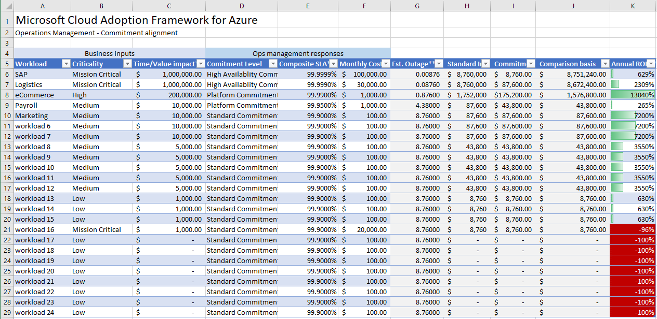
Ops Management planning workbook
Help capture decisions that result from business alignment conversations
1
2
3
Notes:
To help capture decisions that result from this conversation about term alignment, an Ops Management workbook is available on our GitHub site. This workbook does not perform SLA or cost calculations. It serves only to help capture such measures and forecast return on loss-avoidance efforts.
Alternatively, these same workloads and associated assets could be tagged directly in Azure, if the solutions are already deployed to the cloud.
1: Capture stated criticality from business partners & work define Time/Value impact (revenue impact in case of an outage per hour). Invest as needed through workload operations.
2: Ensure that your management baseline is sufficient to meet a standard commitment for all workloads, using Medium criticality as the benchmark
3: Before investing heavily in workload operations, validate that criticality definitions are consistent. I.E. a mission critical app with a significantly lower Time/Value impact may not really be mission critical & may make it hard to justify investment. Especially when reviewing the ROI of that investment.
Create business alignment in cloud management Ref: https://docs.microsoft.com/en-us/azure/cloud-adoption-framework/manage/considerations/business-alignment
Ops Management workbook Ref: https://raw.githubusercontent.com/microsoft/CloudAdoptionFramework/master/manage/opsmanagementworkbook.xlsx

Slide 149
Fulfilling business commitments

Slide 150
Methodology to enable cloud management
Cloud operations disciplines
Business Alignment
1
Criticality
Establish management baseline
Management
baseline
Inventory and visibility
Operational compliance
Protect and recover
Impact
Enhanced baseline
Platform specialization
Workload specialization
Advanced
operations
Commitment
Expand management baseline
Advanced operations and design principals
Define business commitments
3
4
2
Notes:
The first three cloud management disciplines describe a management baseline. The preceding articles in this guide outline a minimum viable product (MVP) for cloud management services, which is referred to as a management baseline.
The purpose of a management baseline is to create a consistent offering that provides a minimum level of business commitment for all supported workloads. With this baseline of common, repeatable management offerings, the team can deliver highly optimized operational management with minimal deviation.
However, you might need a greater commitment to the business beyond the standard offering.
Workload operations:
Largest per-workload operations investment.
Highest degree of resiliency.
Suggested for the approximately 20% of workloads that drive business value.
Typically reserved for high-criticality or mission-critical workloads.
Platform operations:
Operations investment is spread across many workloads.
Resiliency improvements affect all workloads that use the defined platform.
Suggested for the approximately 20% of platforms that have highest criticality.
Typically reserved for medium-criticality to high-criticality workloads.
Enhanced management baseline:
Lowest relative operations investment.
Slightly improved business commitments using additional cloud-native operations tools and processes.
Enhanced management baseline in Azure Ref: https://docs.microsoft.com/en-us/azure/cloud-adoption-framework/manage/azure-management-guide/enhanced-baseline?tabs=AzureAutomation%2CAzureSecurityCenter

Slide 151
Expand management baseline

Slide 152
Cloud management for cloud adoption efficiency
Establish management baseline
Define the criticality classifications, cloud management tools, and processes
1
Define business commitments
Document supported workloads to establish operational commitments
2
Expand management baseline
Make use of the included best practices based on business commitments and operations decisions
3
Advanced operations & design principals
Use a deeper architecture review to deliver on resiliency and reliability commitments
4
Notes:
Phase introduction slide

Slide 153
Enhance management baseline
Why do you need this?
Outline a minimum viable product (MVP) for cloud management services, referred to as a management baseline, and add common improvements to the baseline.
Goals for management baseline
In addition to management baseline, improve business commitments with enhanced management baseline
Improve uptime and decrease recovery times for the entire portfolio of workloads with cloud-native tools
Notes:
Why we need to enhance the management baseline
The management baseline outlines a minimum viable product (MVP) for cloud management services, and adds common improvements to the baseline that can further help organizations go beyond the management baseline and enhanced business commitments.
Goals for management baseline
To reduce the number of workloads that require such investments, an enhanced management baseline can provide enough of an improvement to the business commitment
Improve uptime and decrease recovery times with cloud-native tools and processes to better achieve greater business commitments

Slide 154
Methodology to enable cloud management
Cloud operations disciplines
Business Alignment
1
Criticality
Establish management baseline
Management
baseline
Inventory and visibility
Operational compliance
Protect and recover
Impact
Enhanced baseline
Platform specialization
Workload specialization
Advanced
operations
Commitment
Expand management baseline
Advanced operations and design principals
Define business commitments
3
4
2
Notes:
If your business needs additional levels of commitment from the standard level of management baseline, you can define the next level of commitment with enhanced management baseline. This is made in acceptance with the business and costs associated with the enhanced baseline-managed offering. Although these enhancements aren't cost effective for every workload, there should be common processes, tools, and solutions for any workload that can justify the cost of the extra management support.

Slide 155
Enhanced baseline
Advanced operations
Azure tools and services
Azure Resource Graph
IT Service Management Connector
Azure Automation
Azure Automation Hybrid Runbook Worker
Desired State Configuration (DSC)
Azure Security Center
Evaluate common additions to the baseline that might meet business needs
Use enhanced management baseline cloud-native operations tools and processes to extend the business commitment
A number of mission-critical workloads might require enhancements to the management baseline for better commitment
Enhanced baseline can be enabled to perform advanced management operations and processes such as:
Service change tracking
ITSM integration
Operations automation
Multi-cloud operations
Guest automation
Breach notification
Enhanced baseline
Advanced
operations
Notes:
Before enhancing the management baseline, it’s always recommended to first evaluate common additions that can be added to go beyond the management baseline and meet business needs.
Use enhanced management baseline cloud-native operations tools and processes across inventory and visibility, operation compliance, and recovery and protection to extend the business commitment.
A number of mission-critical workloads might require enhancements to the management baseline for better commitment.
Enhanced baseline can be enabled to perform advanced management operations and processes such as:
Service change tracking, which gives greater visibility into changes to Azure services and might help detect negative effects sooner or remediate faster.
ITSM integration to automated ITSM connection.
Operations automation, which automates operational compliance for faster, more accurate response to change.
Automation of operations across multiple clouds.
Guest automation with code-based configuration of guest operating systems to reduce errors and configuration drift.
Breach notification to extend protection to include security-breach recovery triggers.
The Microsoft Cloud Adoption Framework aligns different tools to allow organizations to enhance the management baseline, including:
Azure Resource Graph
IT Service Management Connector
Azure Automation
Azure Automation Hybrid Runbook Worker
Desired State Configuration (DSC)
Azure Security Center

Slide 156
Advanced operations and design principals

Slide 157
Cloud management for cloud adoption efficiency
Establish management baseline
Define the criticality classifications, cloud management tools, and processes
1
Define business commitments
Document supported workloads to establish operational commitments
2
Expand management baseline
Make use of the included best practices based on business commitments and operations decisions
3
Advanced operations and design principals
Use a deeper architecture review to deliver on resiliency and reliability commitments
4
Notes:
Phase introduction slide

Slide 158
Advanced operations and design principles
Why do you need this?
Management specialization is required to improve the design of common systems (platforms) or specific workloads to effectively minimize interruptions.
Goals for management baseline
Improve the resiliency and design of business workloads
Detect trends and provide automated remediation
Create repeatable solutions to minimize maintenance overhead
Use advanced monitoring tools to discover incremental improvements
Notes:
Why you need advanced operations and design principles
Aspects of workload and platform operations might require changes to design and architecture principles. Management specialization is required to improve the design of common systems (platforms) or specific workloads to effectively minimize interruptions.
Goals for management baseline
Improve the resiliency and design of business workloads that can help in minimizing business interruptions
Detect trends and provide automated remediation
Create repeatable solutions to minimize maintenance overhead by aligning the cloud platform team and cloud automation team
Use advanced monitoring tools to discover incremental improvements to address in the next pass of system design, automation, and scale.

Slide 159
Methodology to enable cloud management
Cloud Operations Disciplines
Business Alignment
1
Criticality
Establish management baseline
Management
baseline
Inventory and visibility
Operational compliance
Protect and recover
Impact
Enhanced baseline
Platform specialization
Workload specialization
Advanced
operations
Commitment
Expand management baseline
Advanced operations and design principals
Define business commitments
3
4
2
Notes:
Advanced operations and design principles extend to areas of specialization, including platform specialization and workload specialization. Workload specialization is usually reserved for high criticality or mission-critical workloads. On the other hand, platform specialization is usually reserved for medium to high criticality workloads.
Let’s look into each area of specialization.

Slide 160
Platform specialization
Advanced operations
Azure tools and services
Azure Managed Applications
Azure Monitor for containers
Azure SQL analytics
SQL Server health check
Azure Automation
Azure Architecture Framework
Invest in ongoing operations of a specific workload, generally reserved for mission-critical workloads
Platform specialization consists of a disciplined execution of the following processes in an iterative approach:
Improve the design of common systems (platforms) or specific workloads by considering best practices for architecture frameworks with Azure Architecture Frameworks
Minimize business interruptions with Azure Architecture Framework by improving systems designs with scalability, availability, resiliency, security, and management
Automate remediation and reduce the impact of interruptions
Scale changes across the environment through the service catalog
Discover incremental improvements to address in the next pass of system design, automation, and scale
Platform operations
Platform specialization
Notes:
Much like the enhanced management baseline, platform specialization is an extension beyond the standard management baseline. Investing in ongoing operations of a specific workload is generally reserved for mission-critical workloads.
Platform specialization consists of a disciplined execution of the following processes in an iterative approach:
Improve the design of common systems (platforms) or specific workloads by considering best practices for architecture frameworks with Azure Architecture Frameworks
Minimize business interruptions with Azure Architecture Framework by improving systems designs with scalability, availability, resiliency, security, and management
Automate remediation and reduce the impact of interruptions; when resolution of technical debt isn't the desired approach, automated remediation is commonly the next step
Scale changes across the environment through the service catalog, where these catalogs can help maximize adoption and minimize maintenance overhead of any optimized platform
Discover incremental improvements to address in the next pass of system design, automation, and scale
The Microsoft Cloud Adoption Framework aligns different tools to enable platform specialization, including:
Azure Managed Applications
Azure Monitor for containers
Azure SQL analytics
SQL Server health check
Azure Automation
Azure Architecture Framework

Slide 161
Workload specialization
Advanced operations
Azure tools and services
Azure Monitor logs
Application Insights
Azure Automation
Azure Architecture Framework
Invest in ongoing operations of a shared platform, distributing the investment across multiple workloads
Trigger a cultural change in traditional IT build processes that focus on delivering a management baseline, enhanced baselines, and platform operations
Apply best practices for improving the resiliency and design of a specific system with Azure Architecture Frameworks
Get the flexibility of advanced monitoring of options for monitoring performance, availability, usage, and dependencies
Operational tasks shift to an application-development or business-unit organization
Application insights—to get deep insights on the specific workload—are required to provide clear workload operations
Workload operations
Workload specialization
Notes:
Workload specialization is similar in execution to platform specialization. But unlike common platforms, the specialization required by individual workloads often doesn't scale. When workload specialization is required, operational management commonly evolves beyond a central IT perspective. Invest in ongoing operations of a shared platform to distribute the investment across multiple workloads.
Workload specialization often triggers a cultural change in traditional IT build processes that focus on delivering a management baseline, enhanced baselines, and platform operations.
Apply best practices for improving the resiliency and design of a specific system with Azure Architecture Frameworks
Get the flexibility of advanced monitoring of options for monitoring performance, availability, usage, and dependencies
Operational tasks shift to an application-development or business-unit organization
Application insights—to get deep insights on the specific workload around performance, availability, usage, and dependencies—are required to provide clear workload operations
The Microsoft Cloud Adoption Framework aligns different tools to enable workload specialization, including
Azure Monitor logs
Application Insights
Azure Automation
Azure Architecture Framework

Slide 162
Task 7 Establish management baseline

Slide 163
Homework Task 1 – Define your strategy together Task 2 – Define your business case for cloud adoption Task 3 – Create your cloud adoption plan Task 4 – Understand ESLZ Design Principles and build your landing zones Task 5 – Evaluate migration options Task 6 – Define your governance model Task 7 – Establish your management baseline

Slide 164
Thank You

